Slide 1
Step by step analysis of ChiP-Seq data by Galaxy

Slide 2
What is ChIP-Sequencing?
ChIP-Sequencing is a new frontier technology to analyze protein interactions with DNA.
ChIP-Seq
  Combination of chromatin immunoprecipitation (ChIP) with ultra high-throughput massively parallel sequencing
  Allow mapping of protein–DNA interactions in-vivo on a genome scale

Slide 3
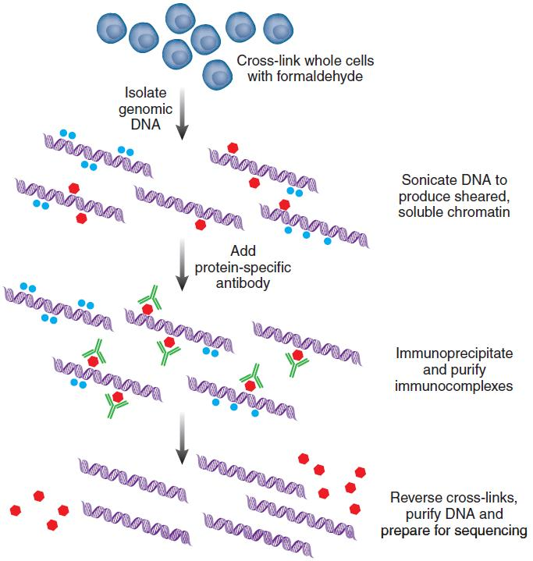
Workflow of
ChIP-Seq
Mardis, E.R. Nat. Methods 4, 613-614 (2007)

Slide 4
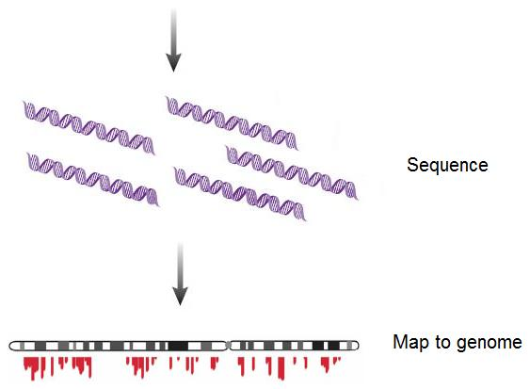
Workflow of
ChIP-Seq

Slide 5
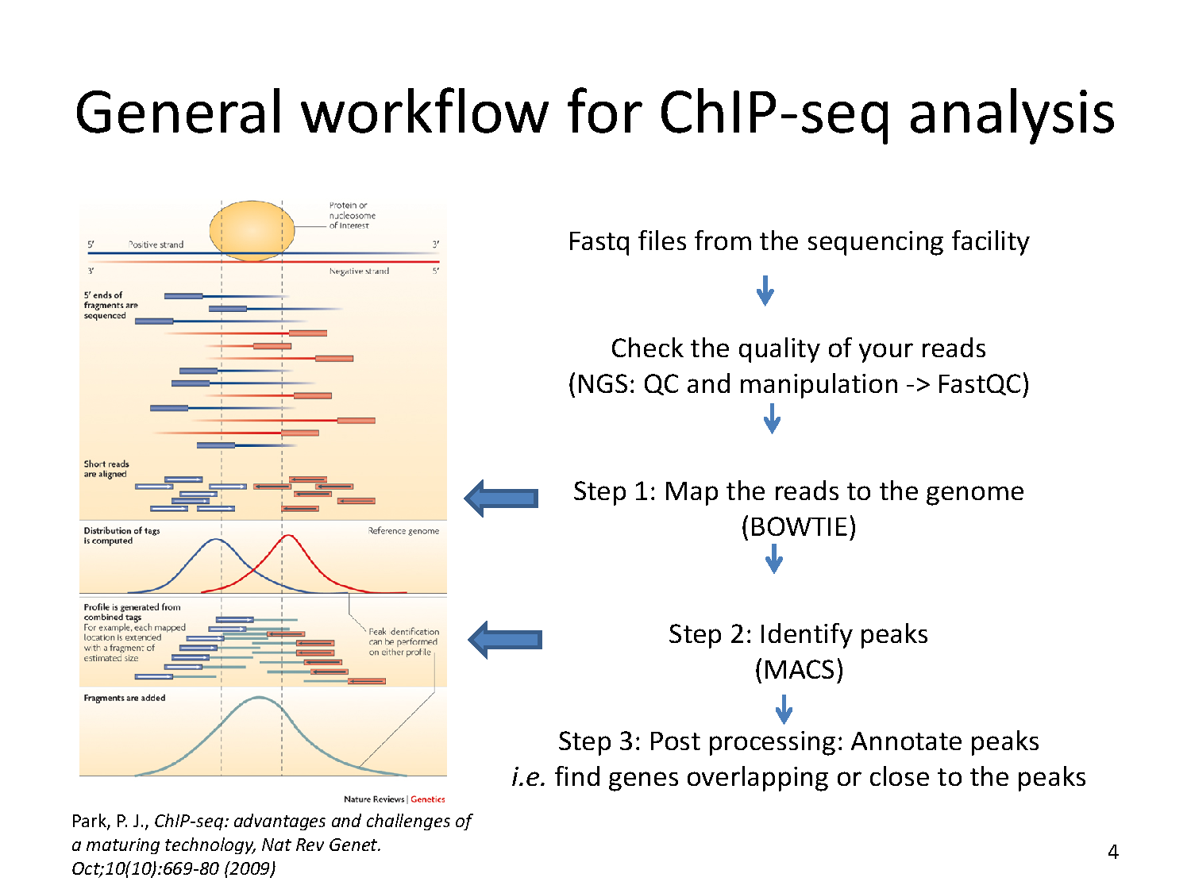

Slide 6
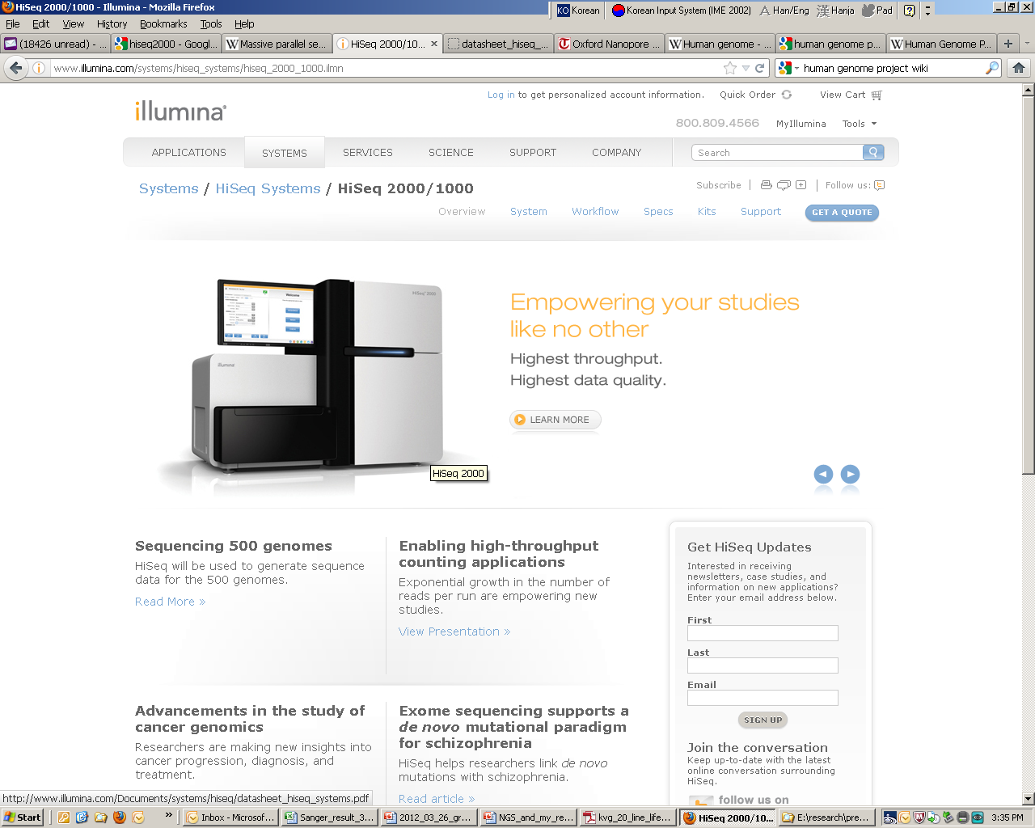
What you get from a sequencer: FASTQ file

Slide 7
What you get from a sequencer: FASTQ file
Millions of sequence fragments and corresponding base call accuracy

Slide 8
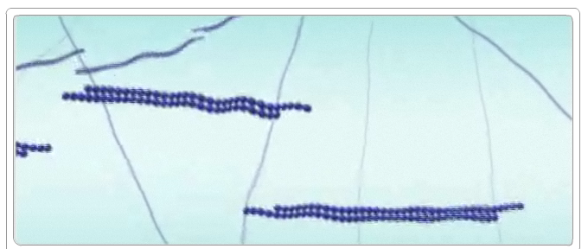
What you get from a sequencer: FASTQ file
➔ Millions of sequence fragments and corresponding base call accuracy
CAGGGCGCGA ATGNTTTCCA CNNNNNNNNN
Sequence

Slide 9
What you get from a sequencer: FASTQ file
➔ Millions of sequence fragments and corresponding base call accuracy
CAGGGCGCGA ATGNTTTCCA CNNNNNNNNN
CFDFFFHHHG GHHHHHGHDB H#########
Sequence
Quality score

Slide 10
What you get from a sequencer: FASTQ file
➔ Millions of sequence fragments and corresponding base call accuracy
CAGGGCGCGA ATGNTTTCCA CNNNNNNNNN
CFDFFFHHHG GHHHHHGHDB H#########
GAATCGATGA AGTNCGGAAA TAGATTNNNN
HEHHHHHHHH BFEEDFGAGG GGGGGE####
AGTNCACTAA GTGTTATTTT AGNNNNNNNN
GAGGDGGGFA FCCCCC<D>7 <<########
…………
Sequence
Quality score

Slide 11
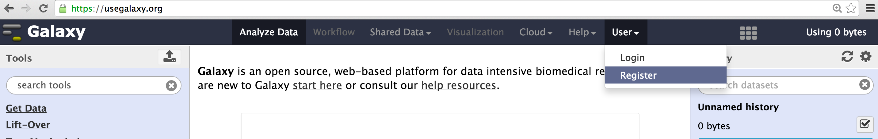
Upload the file
Step 1: Go to the web server, usegalaxy.org
Open a web browser and go to usegalaxy.org
Let’s Register
  Click “User” ➔ “Register”

Slide 12
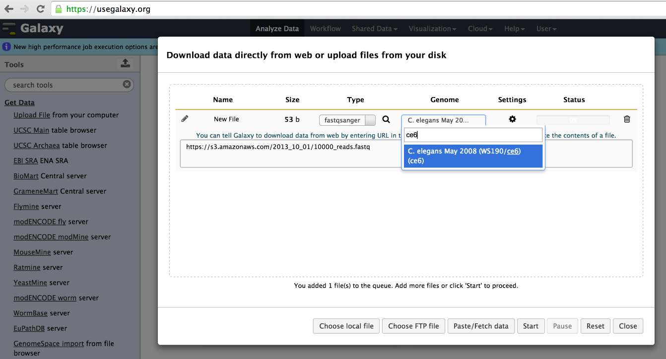
How to upload the data?
Step 2: Upload the fastq file to Galaxy
  Click “Get Data” in the left column
  Click “Upload File from your computer”
  Click “Paste/Fetch data”
  Type “fastqsanger” in the File Format box
  Type the “ce6” to select the C. elegans May 2008 (WS190/ce6)” genome
  In URL/Text box, type the following address
  https://goo.gl/M8p3eZ
  Click “Start” button
  Click “Close” button

Slide 13
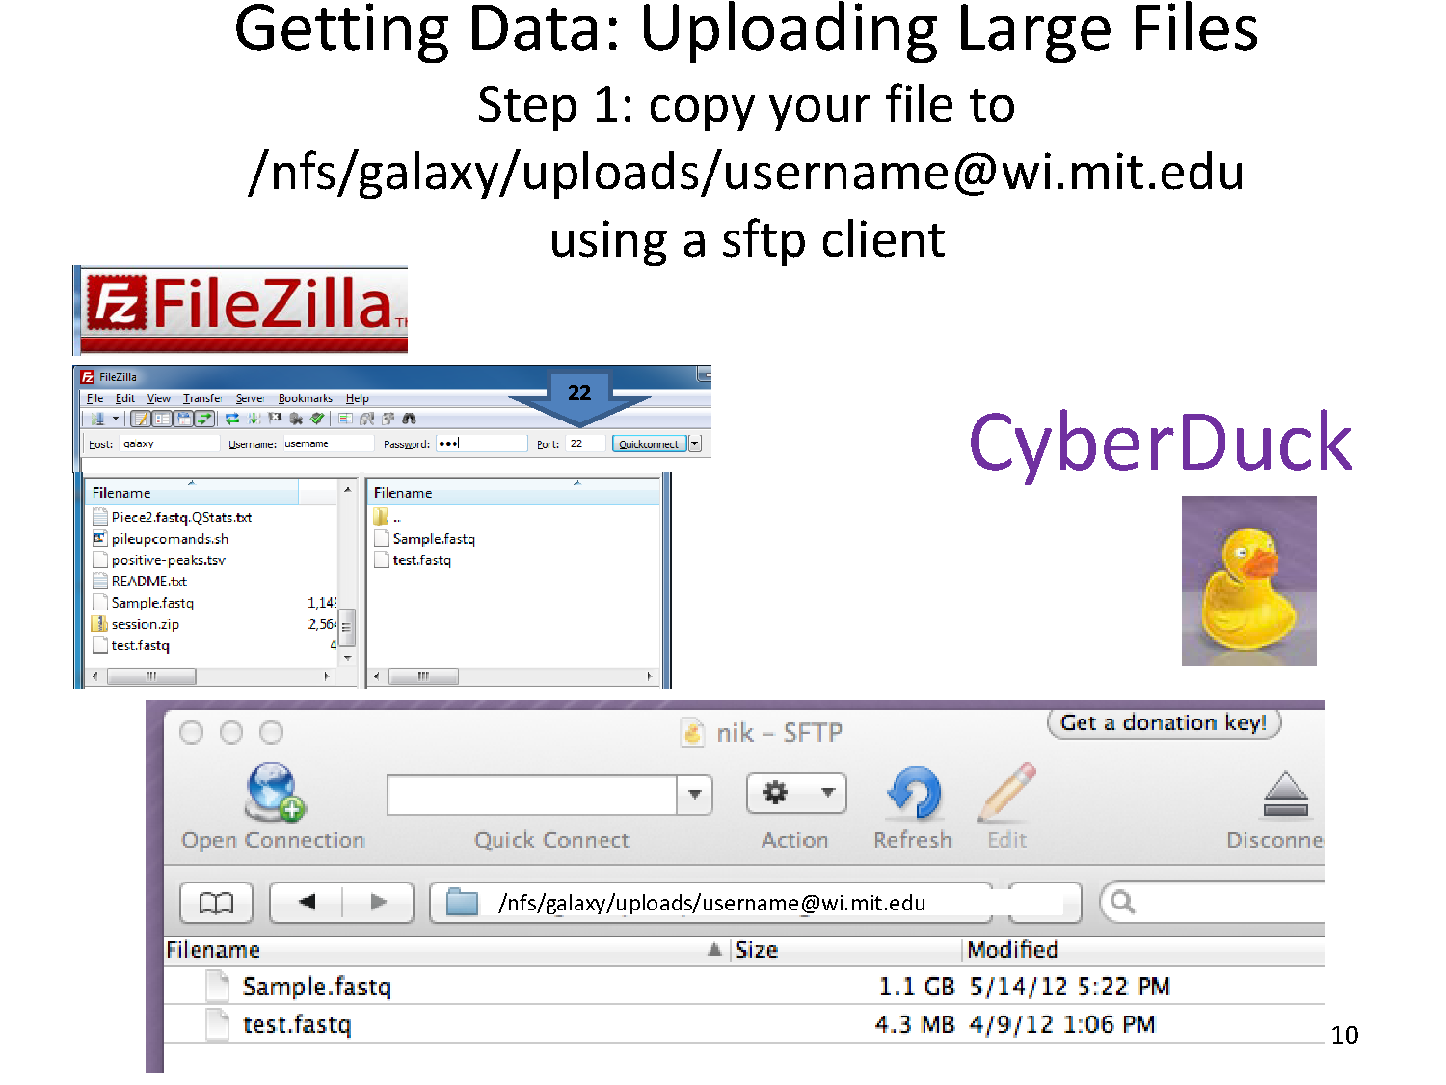
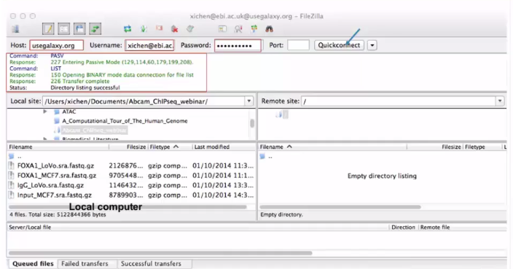

Slide 14

Are you sure you have good quality reads?

Slide 15
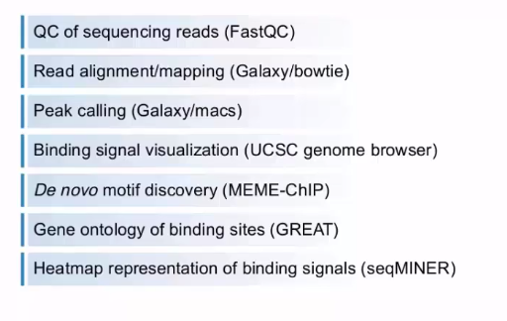
Major steps in CHIP data analysis

Slide 16
(Hands-on) Check the quality of the 10,000 reads
You don’t want to check the quality of 10,000 reads manually ➔ Use software (FASTQC) in a public web server (usegalaxy.org)
  Step 1: Go to the web server, usegalaxy.org
  Step 2: Upload the data (a fastq file that contains 10,000 reads)
  Step 3: Run the tool (FASTQC) in the web server

Slide 17
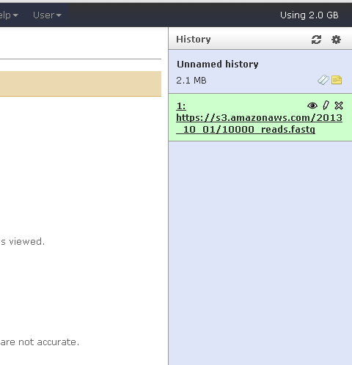
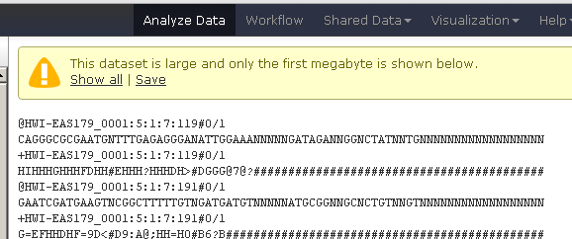
STEP1- FASTQ Analysis
Step 3: Run the tool (FASTQC) in the web server
  1: Make it sure whether you uploaded data correctly by clicking the “eye” icon

Slide 18
FastQC aims to provide a simple way to do some quality control checks on raw sequence data coming from high throughput sequencing pipelines. It provides a modular set of analyses which you can use to give a quick impression of whether your data has any problems of which you should be aware before doing any further analysis.
The main functions of FastQC are:
Import of data from BAM, SAM or FastQ/FastQ.gz files (any variant),
Providing a quick overview to tell you in which areas there may be problems
Summary graphs and tables to quickly assess your data
Export of results to an HTML based permanent report
Offline operation to allow automated generation of reports without running the interactive application

Slide 19
FastQC is the best place to look for documentation - it's very good. A summary follows below for those in a tearing hurry.
This wrapper will accept a Galaxy fastq, fastq.gz, sam or bam as the input read file to check. It will also take an optional file containing a list of contaminants information, in the form of a tab-delimited file with 2 columns, name and sequence. As another option the tool takes a custom limits.txt file that allows setting the warning thresholds for the different modules and also specifies which modules to include in the output.
The tool produces a basic text and a HTML output file that contain all of the results, including the following:
Basic Statistics
Per base sequence quality
Per sequence quality scores
Per base sequence content
Per base GC content
Per sequence GC content
Per base N content
Sequence Length Distribution
Sequence Duplication Levels
Overrepresented sequences
Kmer Content

Slide 20
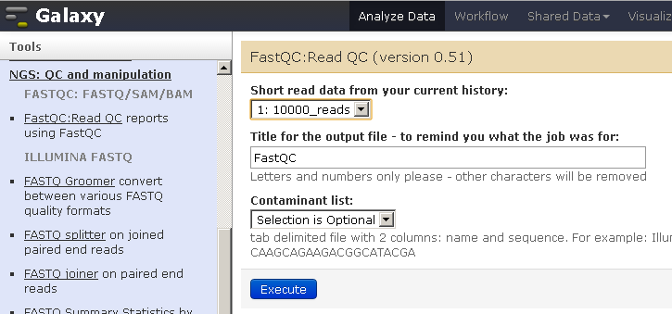
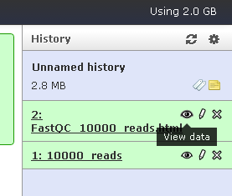
(Hands-on) Check the quality of the 10,000 reads
Step 3: Run the software (FASTQC) in the web server
  2: Run FASTQC software to check the quality
  Click “NGS:QC and manipulation” in the left column
  Click “Fastqc:Read QC reports using FastQC”
  Click “Execute” and wait for ~ 1 min.
  When it is done (yellow ➔ green), click the “eye” icon to see the result.

Slide 21
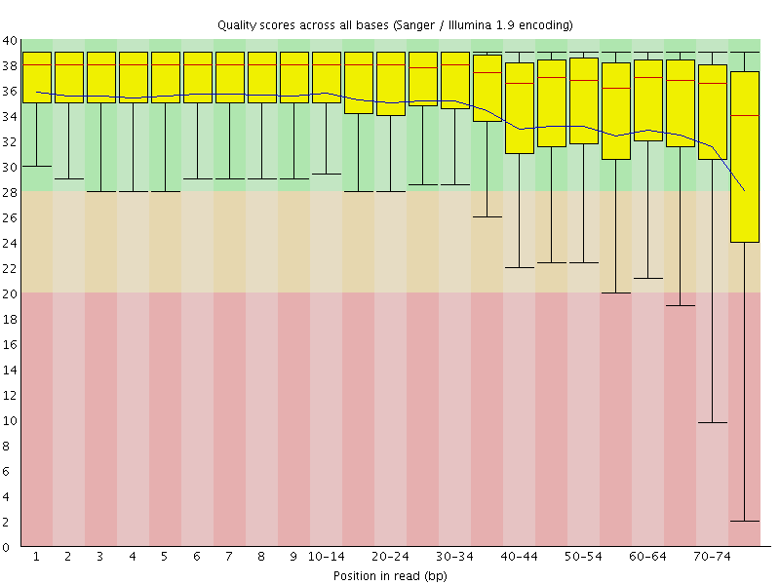
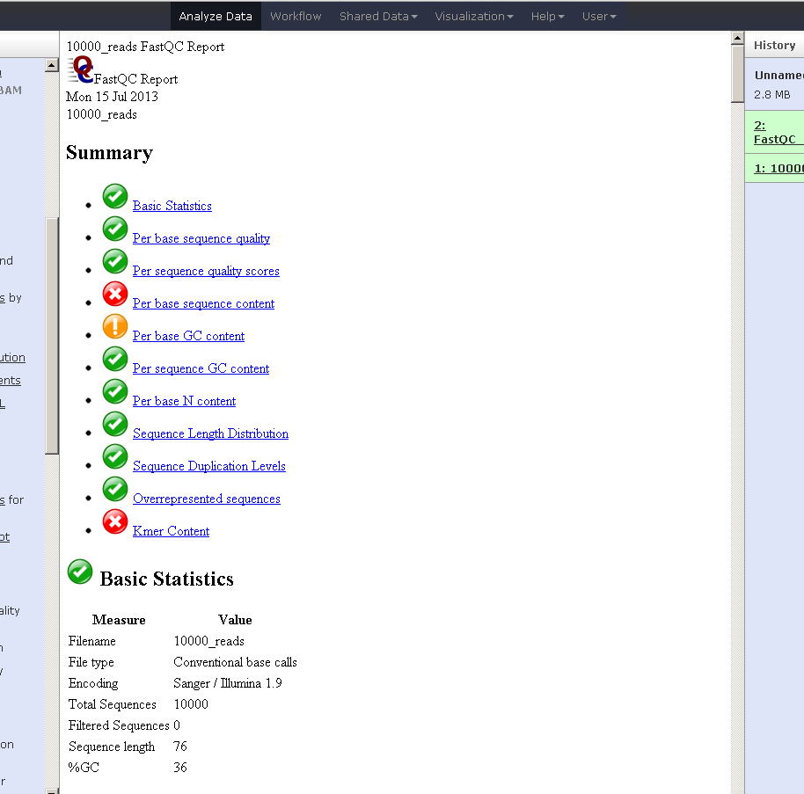
(Hands-on) Check the quality of the 10,000 reads
PHRED
Score
Green color
➔Good quality
➔sequence believable
Details on quality score: Y-axis
PHRED score =

Slide 22
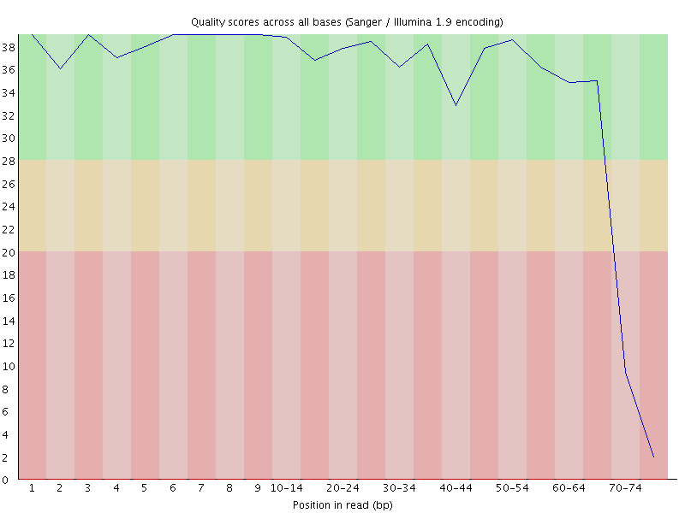
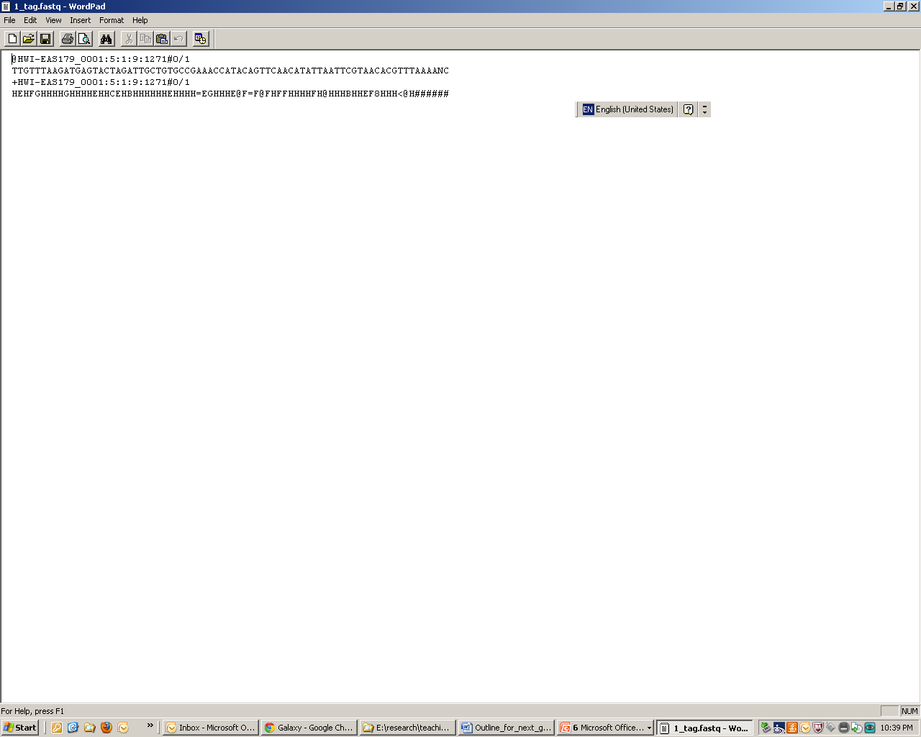
(Q) What to do if my read has bad quality base calls?
PHRED
Score
Good quality = sequence believable
Bad quality= sequence unbelievable
Base position
Sequence
Quality

Slide 23
(Q) What to do if my read has bad quality base calls?
PHRED
Score
Good quality = sequence believable
Bad quality= sequence unbelievable
Base position
Sequence
Quality

Slide 24
What would you do with the base calls of high error rate? ➔ Trimming
Currently, trim them off!
Trimming

Slide 25
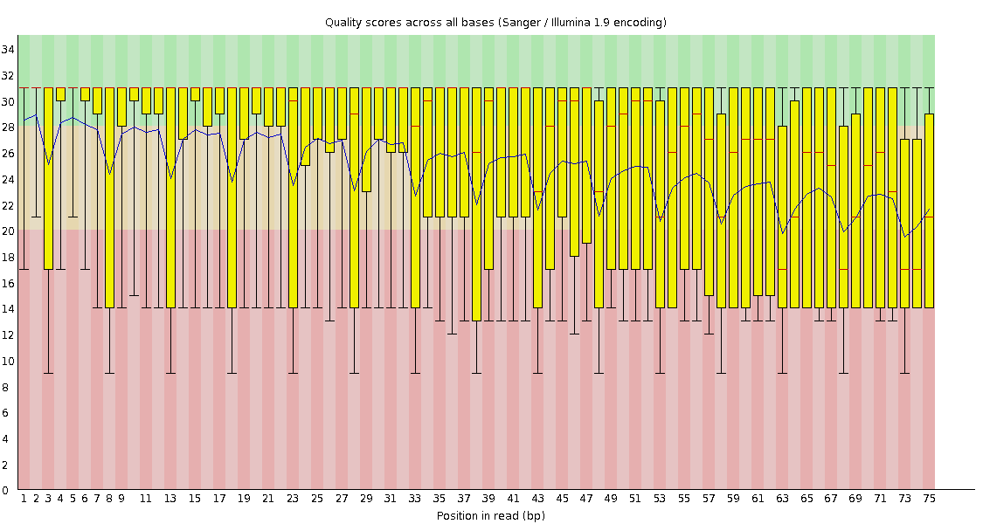
How to trim if you have multiple regions of low quality?

Slide 26
How to interpret Quality score in fastq file?
FASTQ file:
@Read_ID
CAGGGCGCGA ATGNTTTCCA CNNNNNNNNN
+
CFDFFFHHHG GHHHHHGHDB H#########
Sequence
Quality score

Slide 27
How to understand quality score?
(example) We got a sequence of five bases
  Sequence: ACGTA
  The probability of error (P) is 1% for the first base A, 5% for the second and third bases, 10% for the fourth base, and 63% for the fifth base.
  A C G T A
  1% 5% 5% 10% 63%
  Question: How can you simplify this?

Slide 28
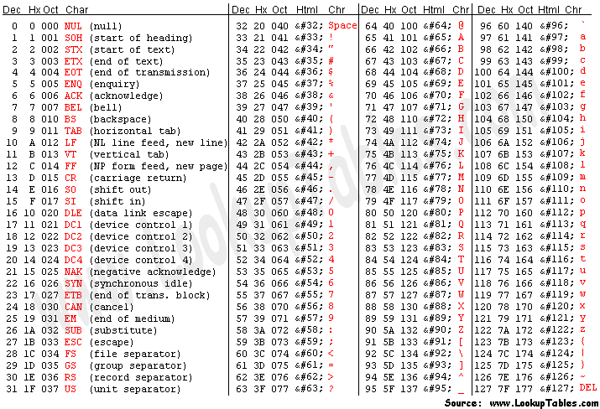
ASCII code table

Slide 29
P_{err} ➔ ASCII character
Step 1: P_{err} ➔ PHRED score =
  (e.g.) P_{err} = 0.01 ➔ PHRED score = 20
Step 2: Add +33 to the PHRED score
  (e.g.) 20 + 33 = 53
Step 3: Get the ASCII character that correspond to the above number
  (e.g.) 53 ➔ 5
PHRED + 33 is called “FASTQ Sanger format”

Slide 30
STEP-2 Conversion of .txt files into FASTQ Format
All Sanger format files saves in .txt files.
These files we can upload in Galaxy server. We can also run FastQC analysis on these files but cannot use other tools like Trimmomatic analysis which require files in FASTQ format.
Use the FASTQ Groomer within Galaxy in order to make Galaxy recognize the format. You can upload the .txt files and convert them with FASTQ Groomer to get the necessary input. I believe the reason for this is that the newer machines are on Sanger format 1.9 and Galaxy requires 1.8.

Slide 31
FASTQ Groomer
This tool offers several conversions options relating to the FASTQ format.
When using Basic options, the output will be sanger formatted or cssanger formatted (when the input is Color Space Sanger).
When converting, if a quality score falls outside of the target score range, it will be coerced to the closest available value (i.e. the minimum or maximum).
When converting between Solexa and the other formats, quality scores are mapped between Solexa and PHRED scales using the equations found in Cock PJ, Fields CJ, Goto N, Heuer ML, Rice PM. The Sanger FASTQ file format for sequences with quality scores, and the Solexa/Illumina FASTQ variants. Nucleic Acids Res. 2009 Dec 16.
When converting between color space (csSanger) and base/sequence space (Sanger, Illumina, Solexa) formats, adapter bases are lost or gained; if gained, the base 'G' is used as the adapter. You cannot convert a color space read to base space if there is no adapter present in the color space sequence. Any masked or ambiguous nucleotides in base space will be converted to 'N's when determining color space encoding.

Slide 32
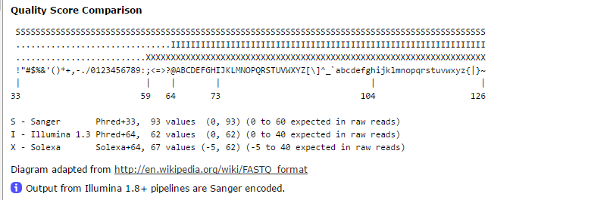

Slide 33
STEP-3 TRIMMOMATIC ANALYSIS
Trimmomatic performs a variety of useful trimming tasks for illumina paired-end and single ended data.
This tool allows the following trimming steps to be performed:
ILLUMINACLIP: Cut adapter and other illumina-specific sequences from the read
SLIDINGWINDOW: Perform a sliding window trimming, cutting once the average quality within the window falls below a threshold
MINLEN: Drop the read if it is below a specified length
LEADING: Cut bases off the start of a read, if below a threshold quality
TRAILING: Cut bases off the end of a read, if below a threshold quality
CROP: Cut the read to a specified length
HEADCROP: Cut the specified number of bases from the start of the read
AVGQUAL: Drop the read if the average quality is below a specified value
MAXINFO: Trim reads adaptively, balancing read length and error rate to maximise the value of each read
If ILLUMINACLIP is requested then it is always performed first; subsequent options can be mixed and matched and will be performed in the order that they have been specified.

Slide 34
Paired-End Sequencing
Paired-end sequencing allows users to sequence both ends of a fragment and generate high-quality, alignable sequence data. Paired-end sequencing facilitates detection of genomic rearrangements and repetitive sequence elements, as well as gene fusions and novel transcripts.
Since paired-end reads are more likely to align to a reference, the quality of the entire data set improves. All Illumina NGS (next-generation sequencing) systems are capable of paired-end sequencing.
Simple Paired-End Libraries: Simple workflow allows generation of unique ranges of insert sizes
  Efficient Sample Use: Requires the same amount of DNA as single-read gDNA or cDNA sequencing
  Broad Range of Applications: Does not require methylation of DNA or restriction digestion; can be used for bisulfite sequencing
  Simplified Data Analysis: Higher quality sequence assemblies with short-insert libraries
Paired-end DNA sequencing reads provide superior alignment across DNA regions containing repetitive sequences, and produce longer contigs for de novo sequencing by filling gaps in the consensus sequence. Paired-end DNA sequencing also detects rearrangements such as insertions, deletions, and inversions.
The combined use of chromatin immunoprecipitation (ChIP) and PET is used to detect regions of DNA bound by a protein of interest. ChIP-PET has the advantage over single read sequencing by reducing ambiguity of the reads generated. The advantage over chip hybridization (ChIP-Chip) is that hybridization tiling arrays do not have the statistical sensitivity that sequence reads have. However, ChIP-PET, ChIP-Seq[5][6][7] and ChIP-chip[8] have all been highly successful.[1]

Slide 35
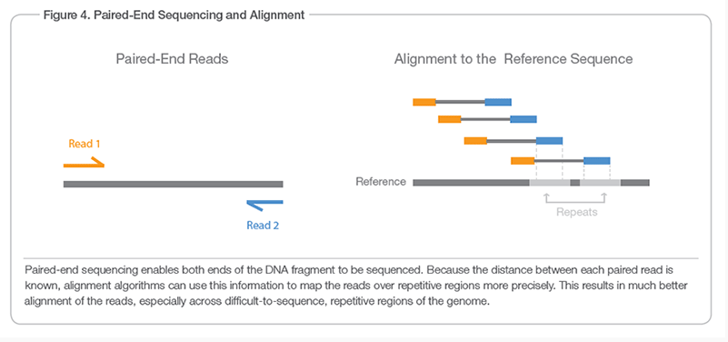

Slide 36
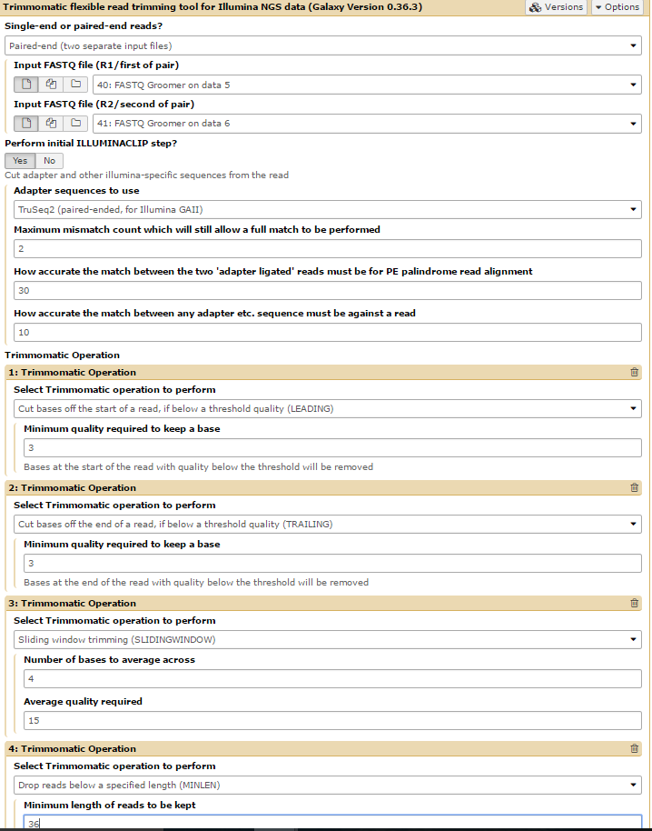
TRIMOMMATIC SETTINGS

Slide 37
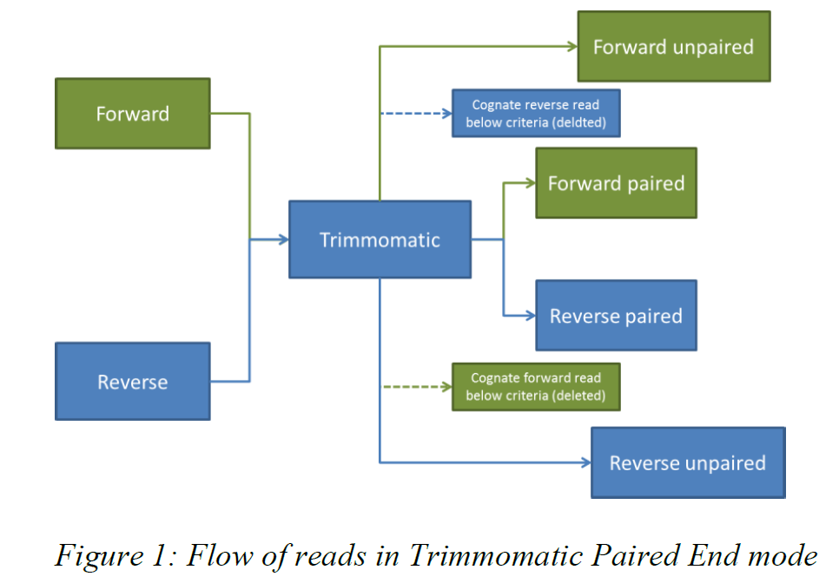
After TRIMOMMATIC SETTINGS- We got Forward and reverse paired end. Then we used these paired end files to Bowtie2 for mapping.

Slide 38
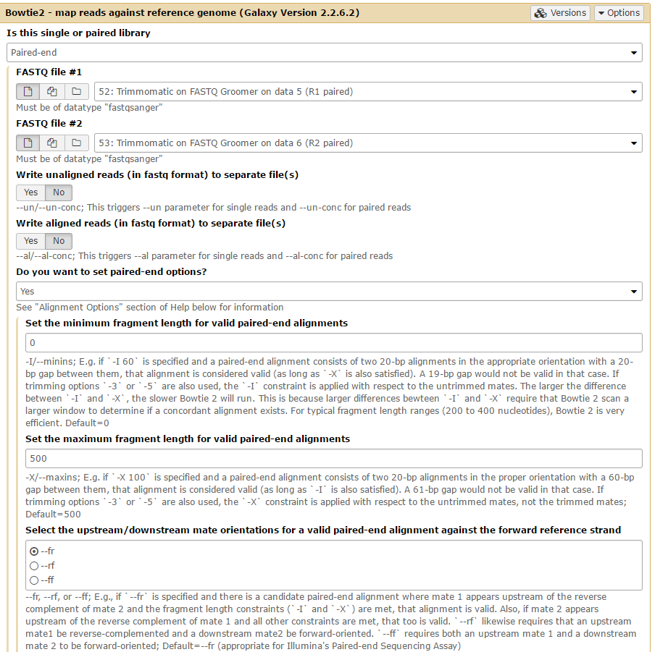
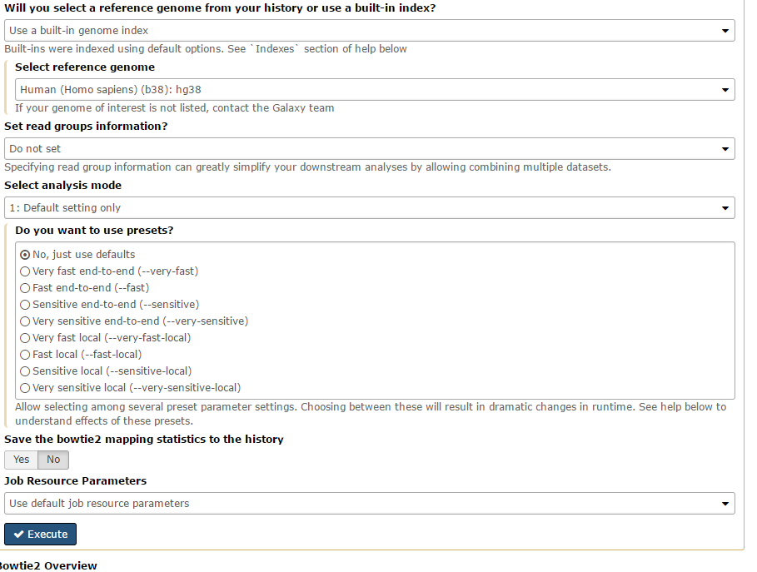
STEP-4 Read alignment/mapping with BOWTIE2
Bowtie2 is an ultrafast and memory-efficient tool for aligning sequencing reads to long reference sequences. It is particularly good at aligning reads of about 50 up to 100s or 1,000s of characters to relatively long (e.g. mammalian) genomes. Bowtie 2 supports gapped, local, and paired-end alignment modes. Galaxy wrapper for Bowtie 2 outputs alignments in BAM format, enabling interoperation with a large number of other tools available at this site. Majority of information in this page is derived from an excellent Bowtie2 manual written by Ben Langmead.

Slide 39
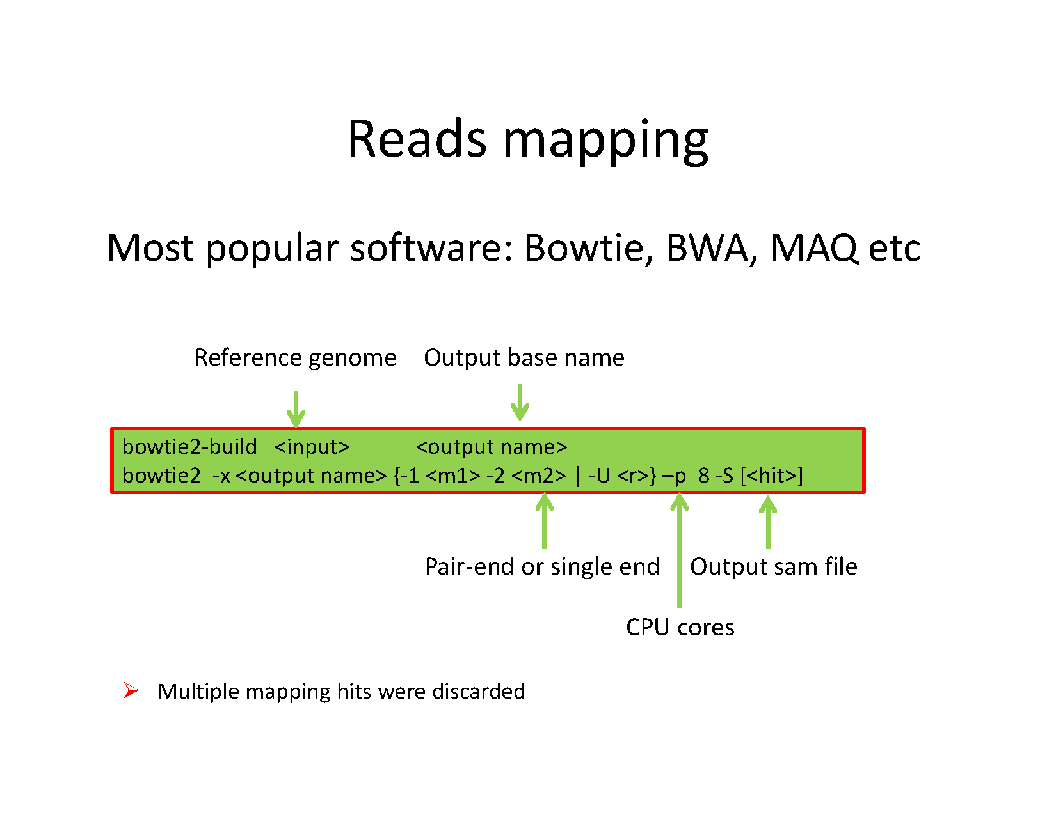

Slide 40
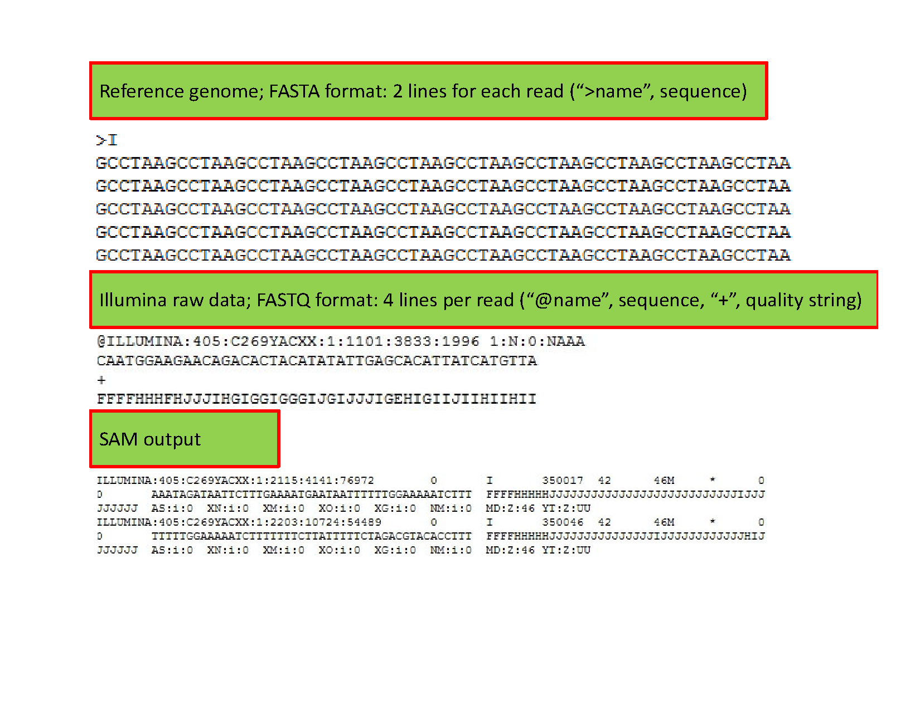

Slide 41
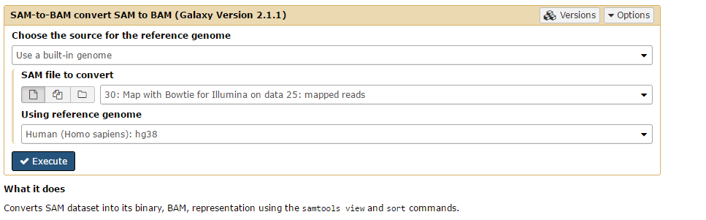
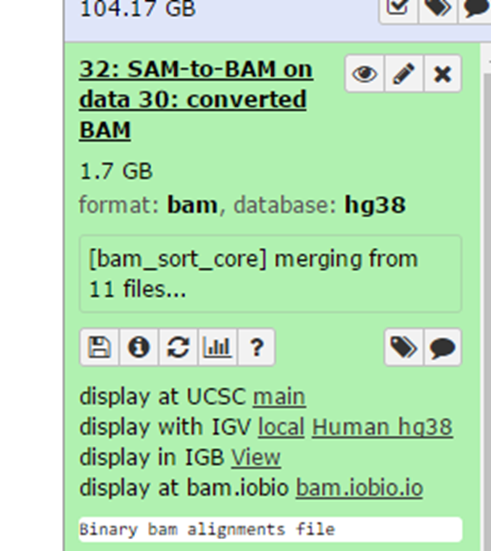

Slide 42
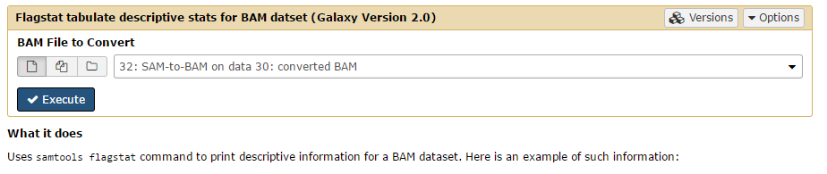
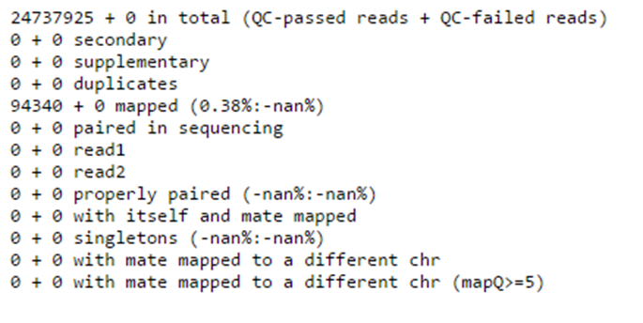
FLAGTOOLS

Slide 43
BAM to BED
What it does
bedtools bamtobed is a conversion utility that converts sequence alignments in BAM format into BED, BED12, and/or BEDPE records.
The "Report spliced BAM alignment..." option breaks BAM alignments with the "N" (splice) operator into distinct BED entries. For example, using this option on a CIGAR such as 50M1000N50M would, by default, produce a single BED record that spans 1100bp. However, using this option, it would create two separate BED records that are each 50bp in size and are separated by 1000bp (the size of the N operation). This is important for RNA-seq and structural variation experiments.
If using a custom BAM alignment TAG as the BED score, note that this must be a numeric tag (e.g., type "i" as in NM:i:0).

Slide 44
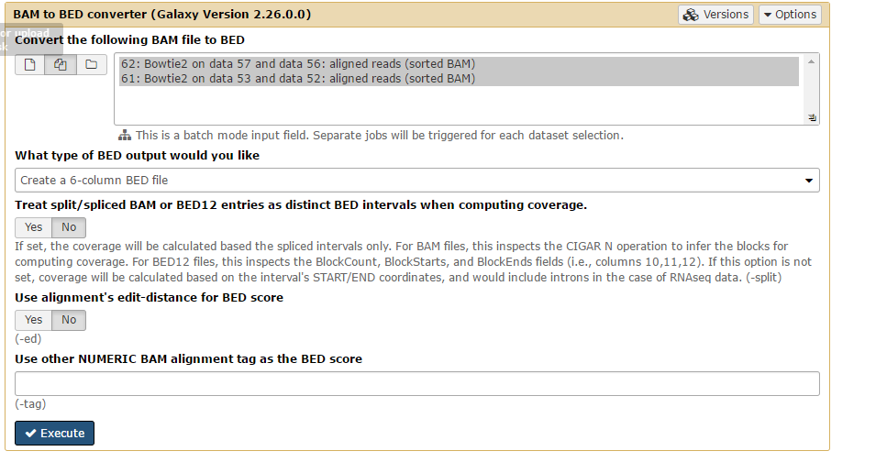
BAM TO BED FORMAT

Slide 45
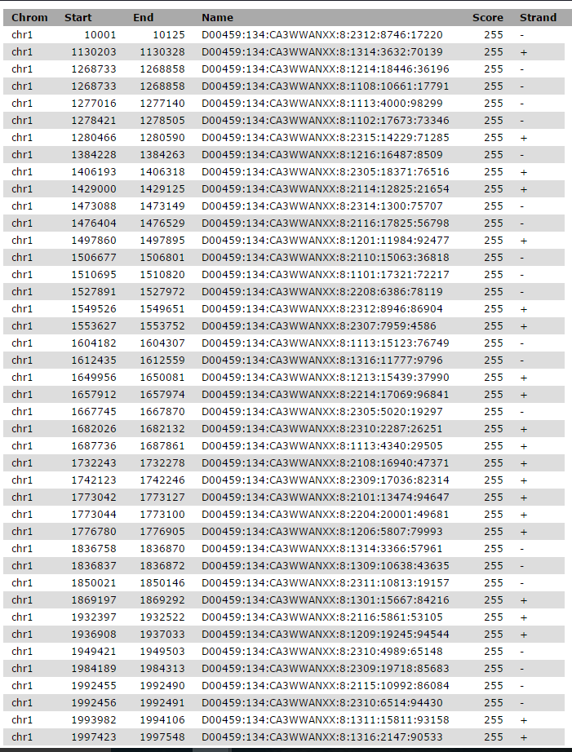


Slide 46
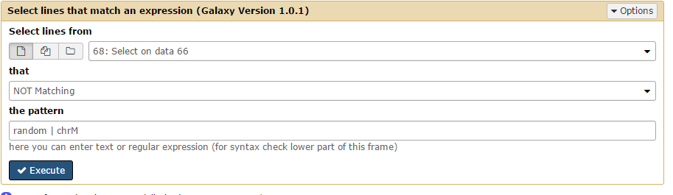
Select tool from Filter and sort

Slide 47
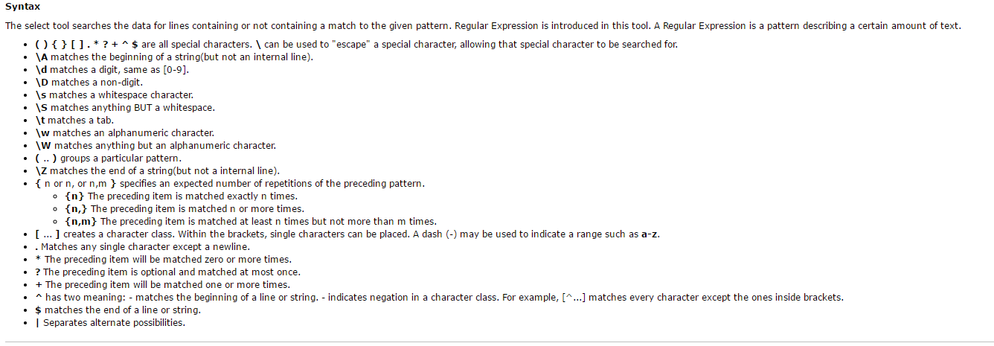

Slide 48
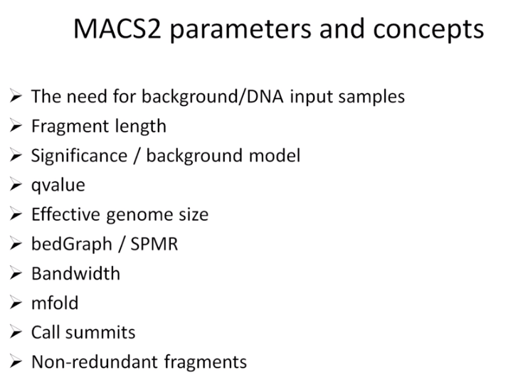

Slide 49
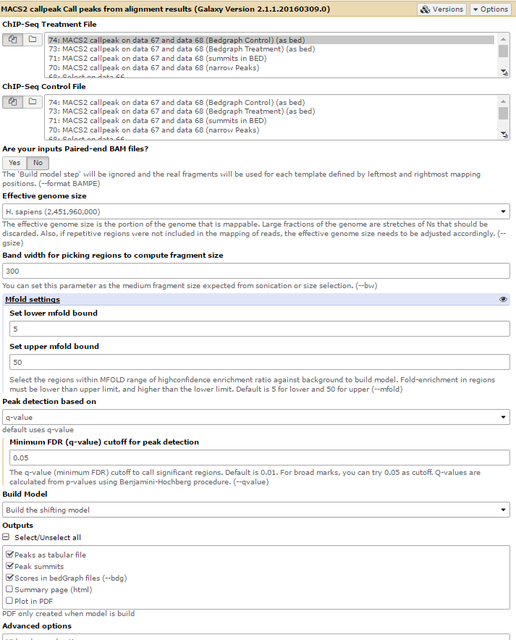

Slide 50
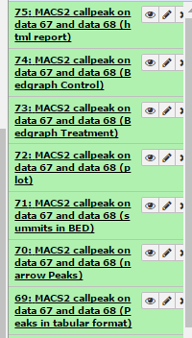
callpeak is the main function of the MACS2 package. MACS identifies enriched binding sites in ChIP-seq experiments. It captures the influence of genome complexity to evaluate the significance of enriched ChIP regions, and improves the spatial resolution of binding sites through combining the information of both sequencing tag position and orientation. MACS can be used for ChIP-Seq data alone, or with control sample with the increase of specificity (recommended).
MACS2 performs the following analysis steps:
Artificially extend reads to expected fragment length, and generate coverage map along genome.
Assume background reads are Poisson distributed. Mean of the Poisson is locally variable and is estimated from control experiment (if available) in 5Kbp or 10Kbp around examined location.
For a given location, do we see more reads than we would have expected from the Poisson (p < 0.00005)? If Yes, MACS2 calls a peak.
Output
Peak calling is a computational method used to identify areas in a genome that have been enriched with aligned reads as a consequence of performing a ChIP-sequencing or MeDIP-seq experiment. These areas are those where a protein interacts with DNA.[1] When the protein is a transcription factor, the enriched area is its transcription factor binding site (TFBS). Popular software programs include MACS.[2] Wilbanks and colleagues[3] is a survey of the ChIP-seq peak callers, and Bailey et al.[4] is a description of practical guidelines for peak calling in ChIP-seq data.

Slide 51
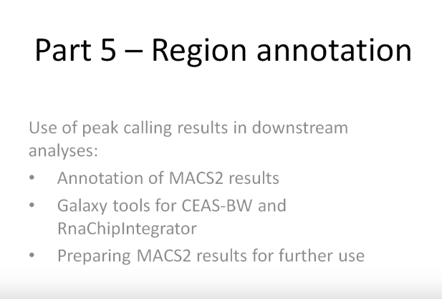

Slide 52
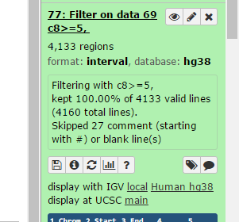
Convert data type from tabular to interval

Slide 53
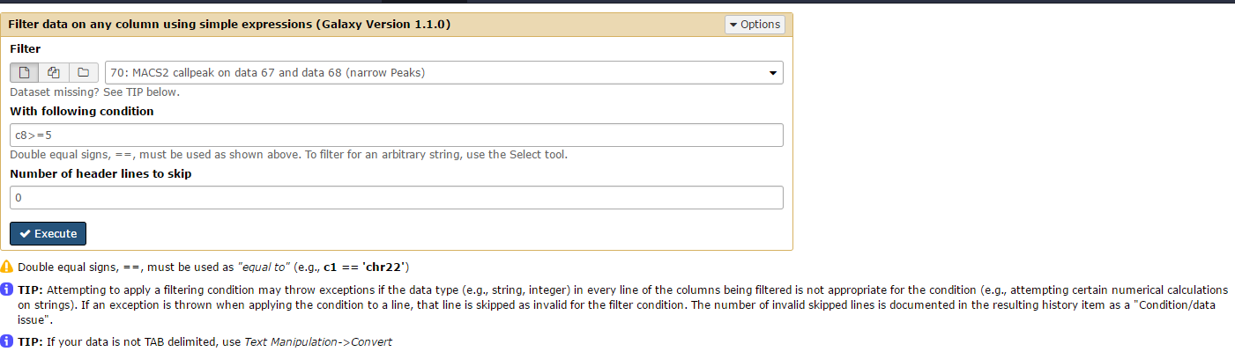
Use tool Filter data

Slide 54
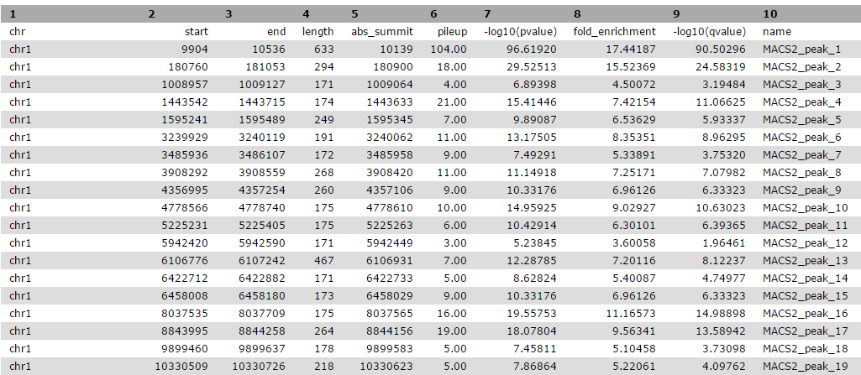

Slide 55
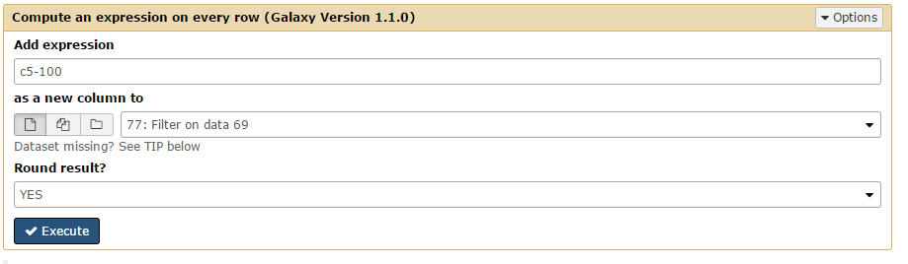
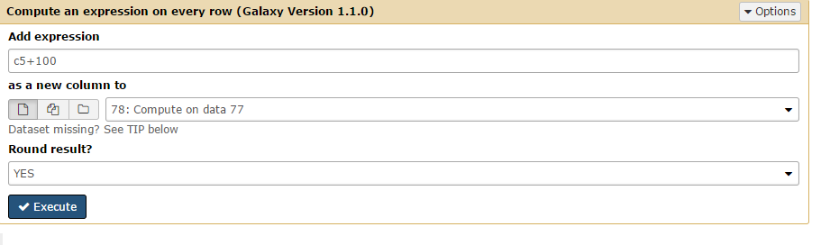

Slide 56
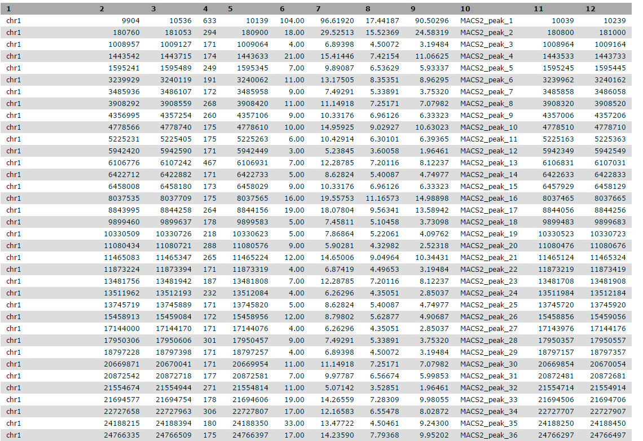

Slide 57
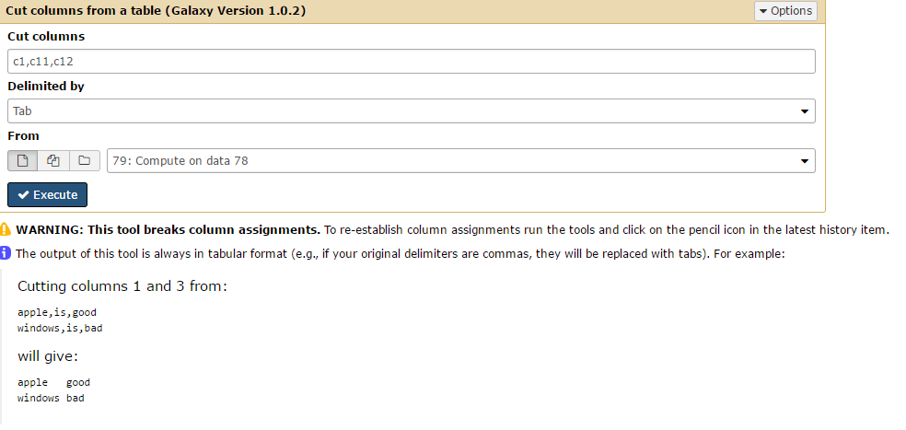

Slide 58
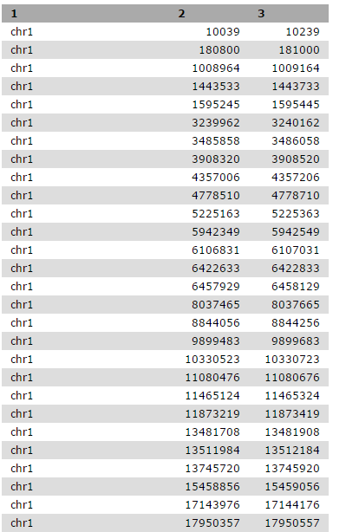
Use cut tool to get only columns 1,12,13

Slide 59
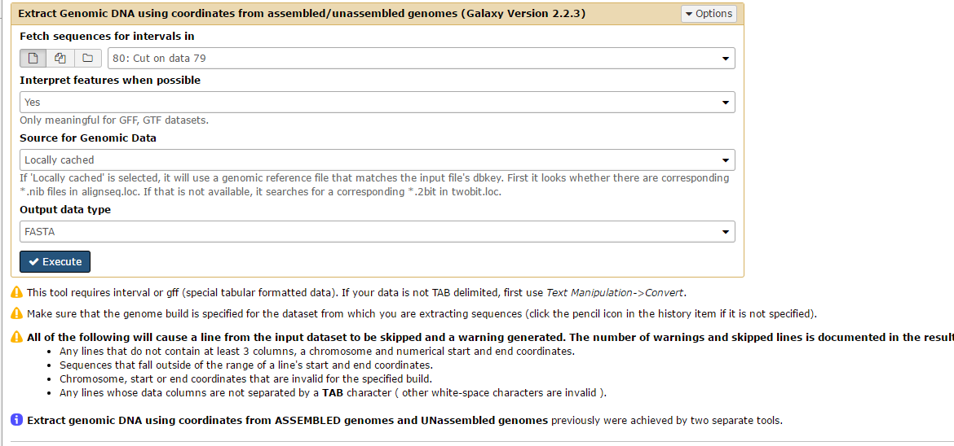

Slide 60
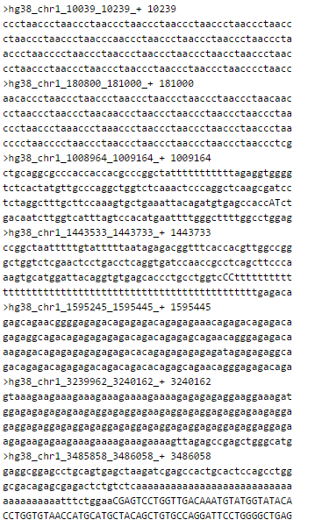

Slide 61
Cistrome Galaxy
CEAS: Enrichment on chromosome and annotation

Slide 62
This tool annotates the given intervals and scores with genome features such as gene body. It's the major module in CEAS package which is written by Hyunjin Gene Shin, published in Bioinformatics (pubmed id:19689956).
Parameters
WIGGLE file contains the scores for the experiment in a wiggle format file. Normally, it's produced by the peak calling tool. It's optional.
BED file contains the peak locations for the experiment in a BED format file.
Span from TSS and TTS in the gene-centered annotation. ChIP regions within this range from TSS and TTS are considered when calculating the coverage rates in promoter and downstream.
Profiling resolution is the WIGGLE profiling resolution.
Promoter/downstream intervals for ChIP region annotation are comma-separated three values or a single value can be given. If a single value is given, it will be segmented into three equal fractions (ie, 3000 is equivalent to 1000,2000,3000)
BiPromoter ranges is for ChIP region annotation. It's comma-separated two values or a single value can be given. If a single value is given, it will be segmented into two equal fractions (ie, 5000 is equivalent to 2500,5000)
Relative distance is the relative distance to TSS/TTS in WIGGLE file profiling
Genome Annotation Version to specify the annotations according to the data set. The annotations are downloaded from UCSC genome site.
Image type specify the output image format, either in PNG or in PDF format.
If Specify gene list in the signal profiling is set, you can specify different gene groups for CEAS to put them together in the profile figure. You need to select several Gene List files from history which contains the RefSeq ids or Gene Symbols for each row, and Gene List Label for each gene list file.

Slide 63




Slide 64

RnaChipIntegrator Integrated analysis of 'gene' and 'peak' data
Performs integrated analyses of genes (or other genomic feature data) gainst a set of peaks (e.g. ChIP data), identifying the nearest peaks to each feature and vice versa.
The program was originally written specifically for ChIP-Seq and RNA-Seq data but works equally well for ChIP-chip and microarray expression data, and can also be used to integrate any set of genomic features (e.g. canonical genes, CpG islands) with expression data.
RnaChipIntegrator can be obtained from https://pypi.python.org/pypi/RnaChipIntegrator/

Slide 65



Slide 66


Peak-centric data
Gene-centric data

Slide 67


NCBI Reference sequence to Gene names
Use this table browser settings and paste the data into paste list

Slide 68


GENE>GENOMIC REGION ASSOCIATED
GENOMIC REGION>GENE ASSOCIATED

Slide 69
Genomic Feature
This is a generic and general term to describe any genomic region with some annotated function. E.g. a gene, CDS, mRNA, rRNA, tRNA, repeat sequence, inverted repeat, miRNA, siRNA, origin of replication. A given genomic feature may be comprised of multiple specific genomic locations that together form the genomic feature. For example, a protein coding gene (CDS) is encoded by a gene that has multiple exons. Each exon is spliced together to form a mature mRNA. The CDS feature itself is therefore comprised of multiple genomic locations that neighbor one another.

Slide 70


GREAT

Slide 71



Slide 72






