Slide 1
Using BaNJO
BAyesian Network Inference with Java Objects

Slide 2
Background
Program to find local maximum networks
Developed by Dr. Alexander J. Hartemink in Duke University
Current version: BaNJO 2.2.0
Forum: Board index > Manuscripts & Documentation > Useful Tools for Statistical Analyses > Banjo
Banjo: https://users.cs.duke.edu/~amink/software/banjo/

Slide 3
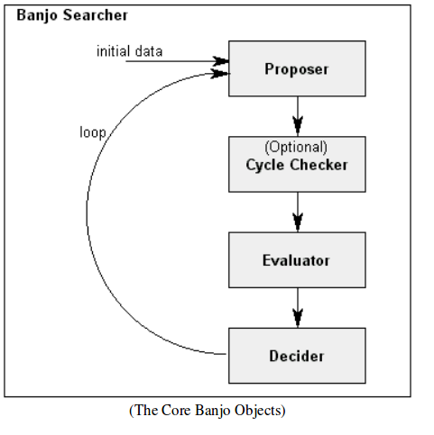
How it works
Proposers: adds/ removes/ reverses arcs at random
  RandomLocalMove
  AllLocalMoves
Decider: accepts/ rejects networks
  Greedy
  Simulated Annealing

Slide 4
Running Banjo: Input files
Data/ Observations must be converted to a text file
Default: Variables as columns, observations as rows
  Can be changed to keep observations as rows, variables as columns
Can specify multiple observation files in settings
  Must have same number of variables
  Must keep variables as columns, observations as rows

Slide 5
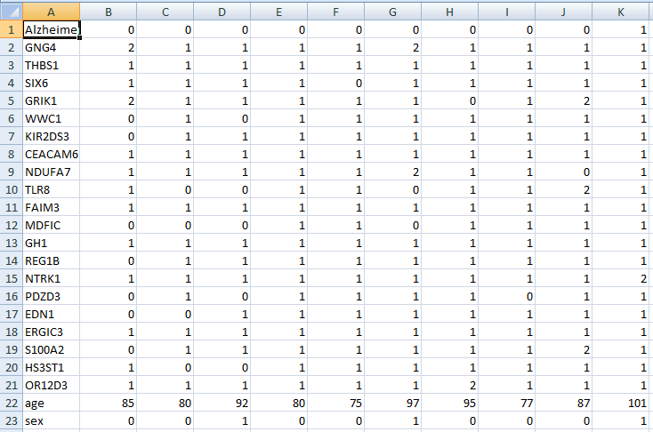

Slide 6
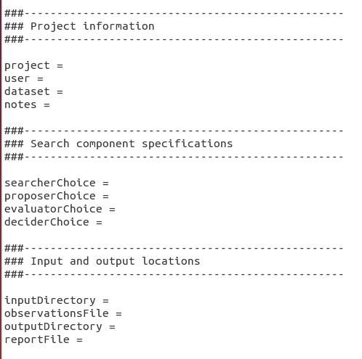
Running Banjo: Settings
Static search
Dynamic search
Settings template available
Sections:
  Project information
  Search components specification
  Input/output locations
  Validated input
  Preprocessing options
  Network structures

Slide 7
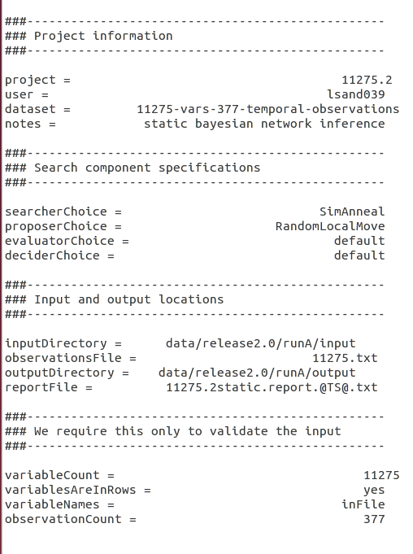
Settings file

Slide 8
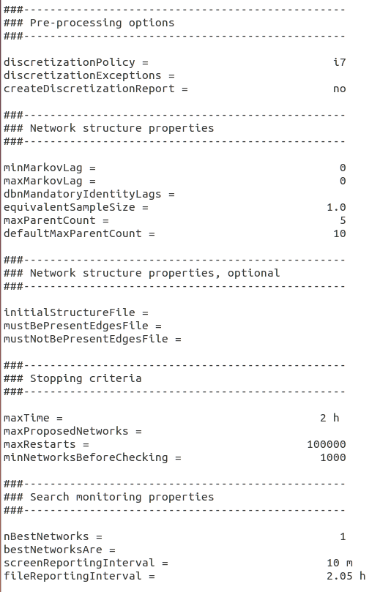
Settings file

Slide 9
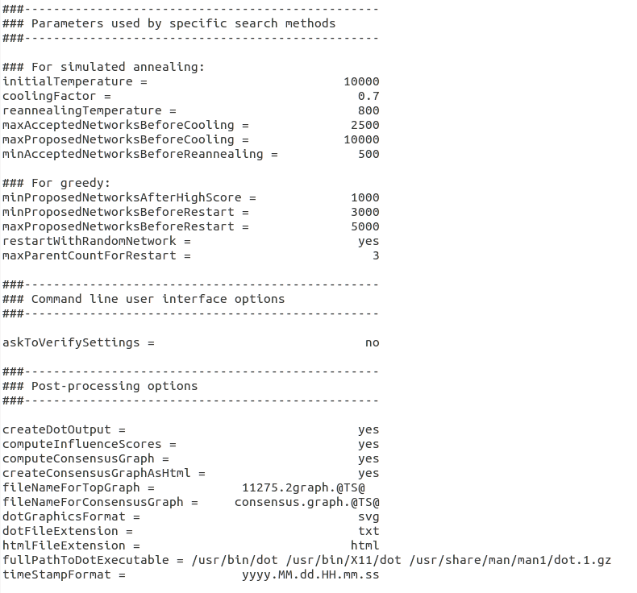
Settings file

Slide 10
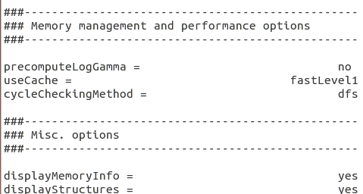
Settings file

Slide 11
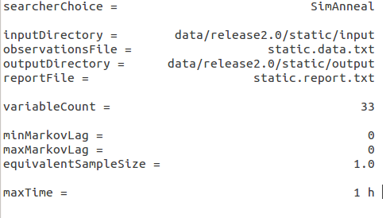
Settings file: Minimum information

Slide 12
Commands
java -jar banjo.jar settingsFile=data/release2.0/static/static.settings.txt
  Must already be in directory where BaNJO is held
  Specify path where settings file is saved
java -jar banjo.jar settingsFile=dynamic.settings.txt settingsDirectory=data/release2.0/dynamic

Slide 13
Running Banjo: Output
Static report
  Summary of input settings
  Descritization report
  Interval reports
  Top graph
  Search statistics
  Influence scores
  Dot graph
Dot text file
  Different format in describing the structure
  May be edited
Dot image file
  Images available:
    Png (default)
    Jpg
    Gif
    Ps
    svg

Slide 14
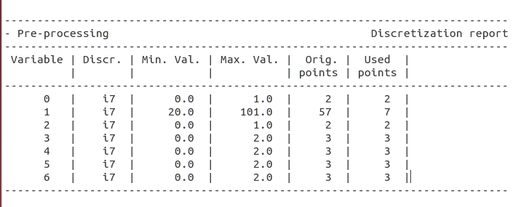
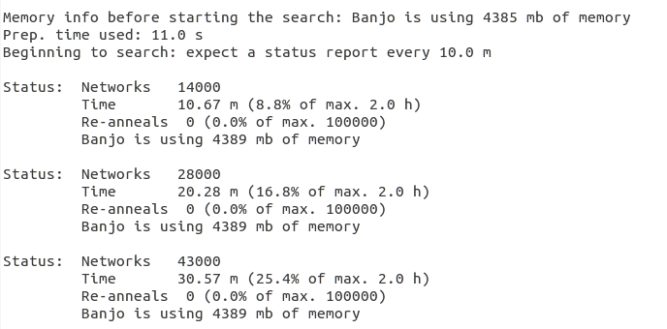

Slide 15
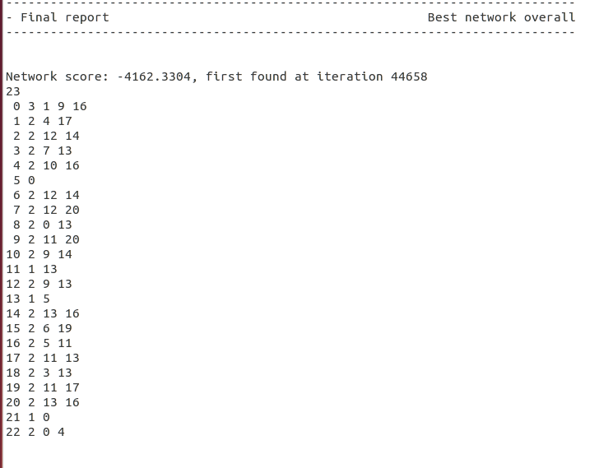

Slide 16
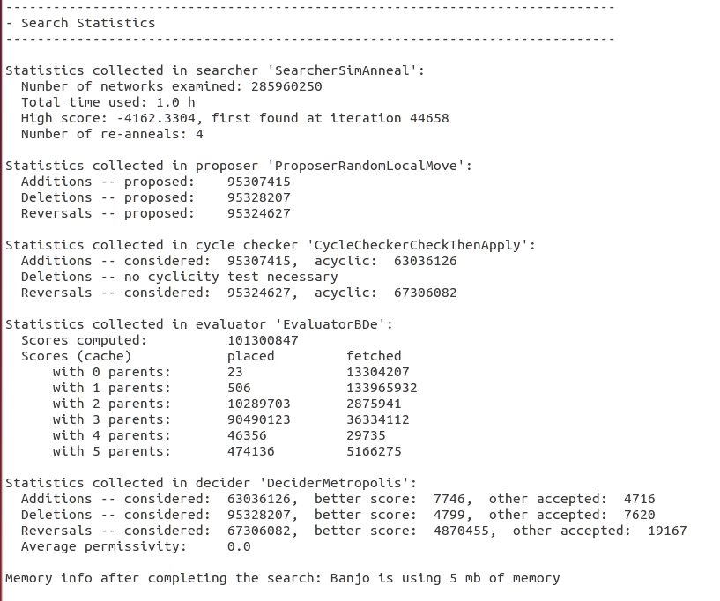

Slide 17
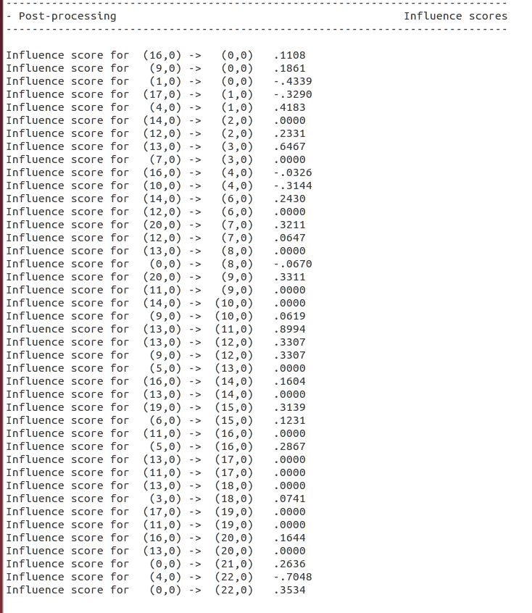

Slide 18
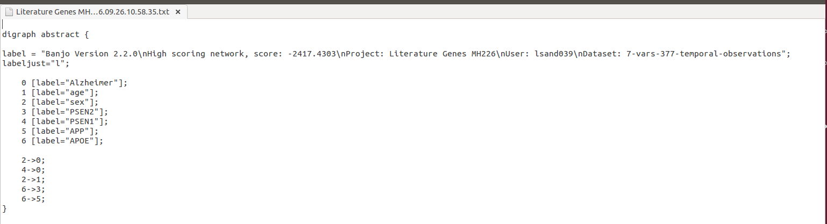
Dot text file
Found at the end of the static report
Separate text file created
Can be edited later to add color to graph

Slide 19
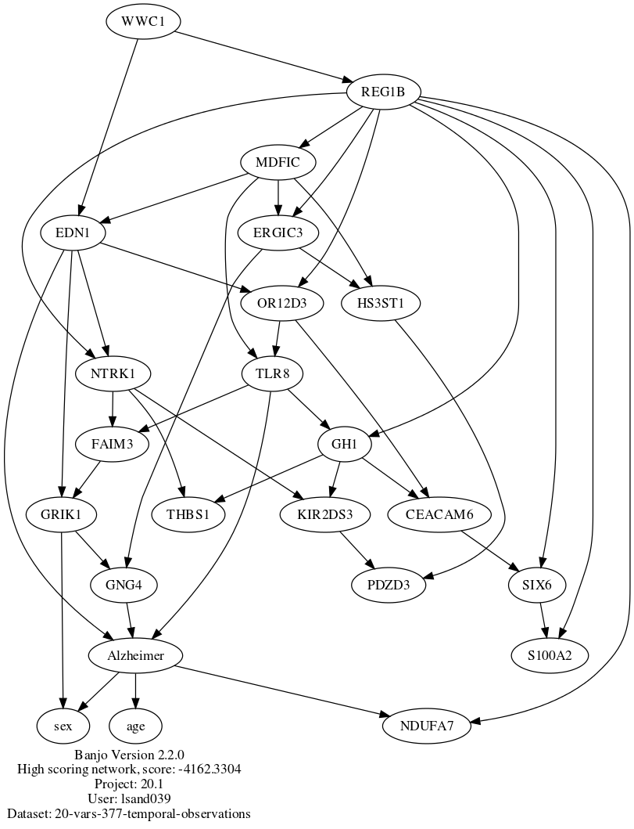
Dot graph

Slide 20
Specifying graphs
Must haves
  Arcs specified must be present in final graph
Must not have
  Arcs specified must not be present in final graph
Initial graphs
  Structure BaNJO starts searching

Slide 21
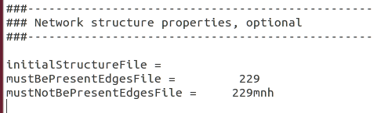
Specifying graphs
Must be saved as a text file
Specify file name in settings
Format:
  Number of variables
  Variable number
  Number of parents
  Parents' variable number
7
0 2 1 2
1 1 0
2 1 0

Slide 22
Scores
Provided as log likelihood
May be converted into probabilities with log_norm.pl
Script found in the forum:
  Board index > Manuscripts & Documentation > Implemented Classes/Modules/Programs Documentation > How to run scripts/programs

Slide 23
More information
Banjo User Guide
  https://users.cs.duke.edu/~amink/software/banjo/documentation/banjo.user.pdf
Banjo Developer Manual
  https://users.cs.duke.edu/~amink/software/banjo/documentation/banjo.developer.pdf
Dot User Guide
  http://graphviz.org/Documentation/dotguide.pdf

Slide 24
Key points
Banjo searches for local maximum likelihood structures
Input files must be text files
  Variables can be in row or columns
  Settings files specify what you want to search for and how long
Output files can include:
  Top graphs & scores
  Influence scores
  Descritization reports
  Dot output
Scores are in log likelihood and can be converted to probabilities to compare graphs.

Slide 25
Thank You!

