Slide 1
Gene-Specific Analysis Results

Slide 2
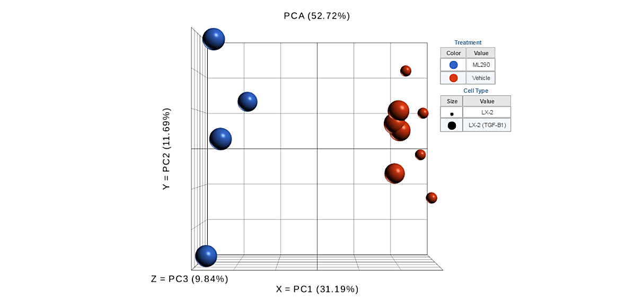
ML290 vs VEHICLE
ON TRANSFORMED LX-2 HSCs

Slide 3
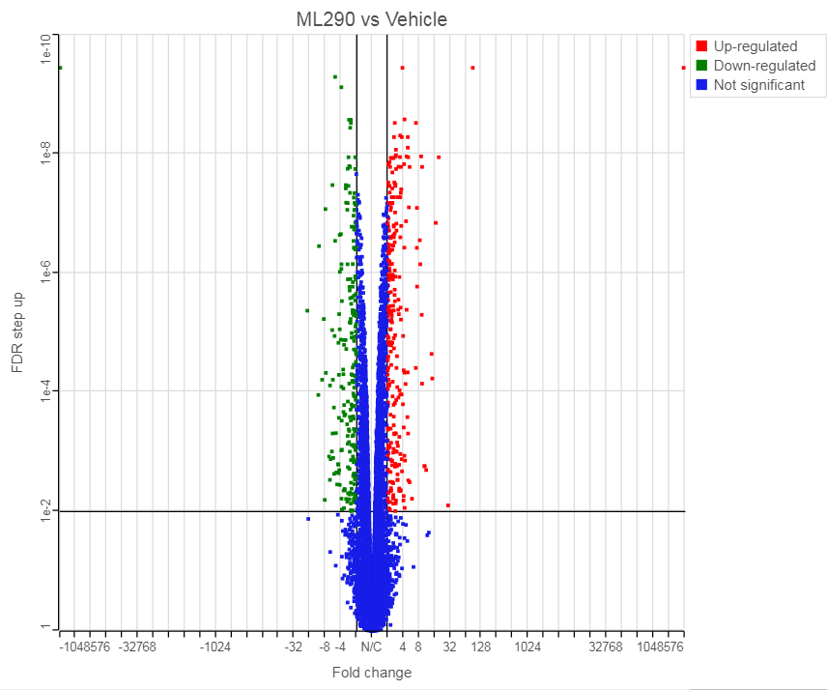
272
225

Slide 4
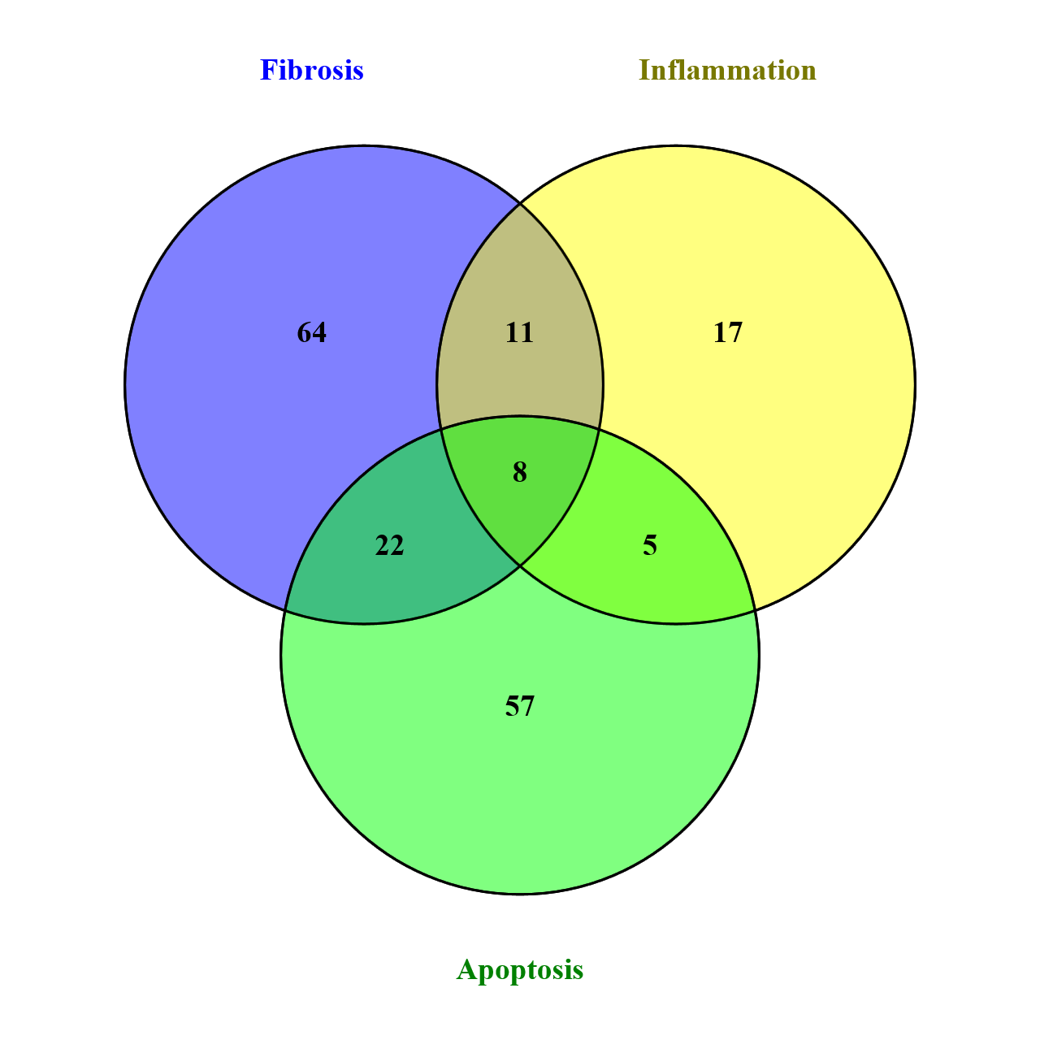

Slide 5


