Slide 1
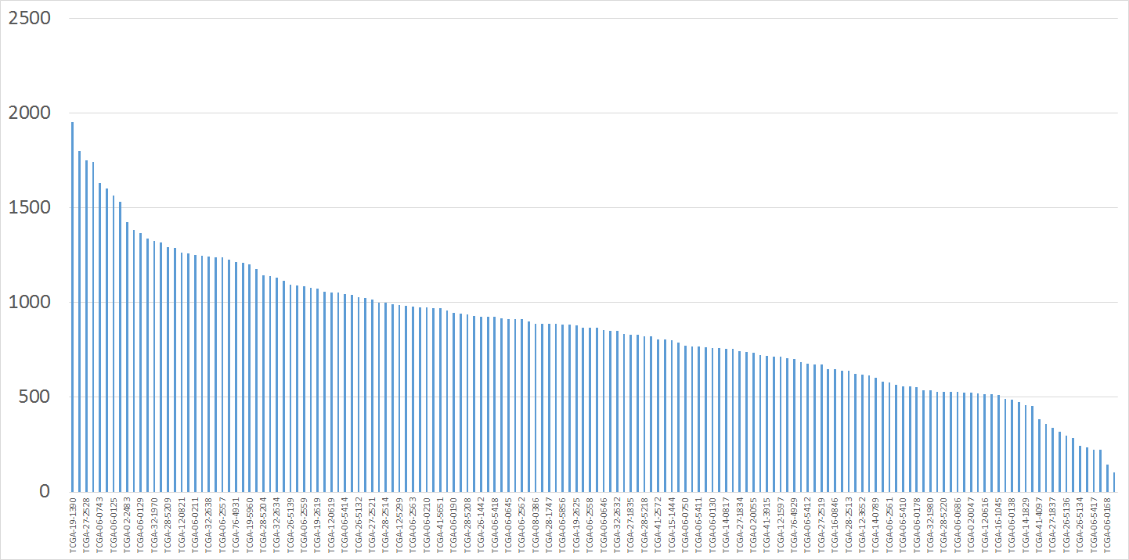
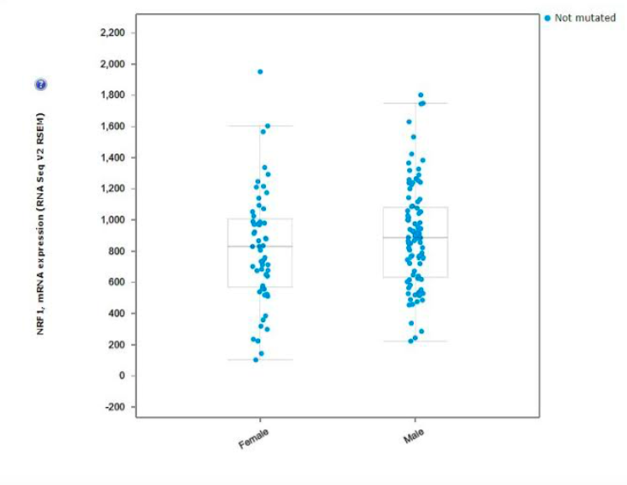
02/23/18 Group Meeting KBh
NRF1 mRNA expression across all 154 patients from the TCGA Cell2013 paper data:
But what does this mean?
mRNA levels (RSEM)
It looks this value is very different from the median, but does that really mean anything in the context of the RNASeq experiment?
Answer this by – Differential Gene Expression Analysis

Slide 2
Differential Gene Expression Analysis (DGEA)
02/23/18 Group Meeting KBh
To compare across samples, necessary to normalize
    Z-score can be used, it is calculated per sample, using mean expression of all probes, and so it artificially compresses the data
    For RT-PCR, housekeeping genes are used to calculate fold change (a ratio) so that ratios can then be compared across samples
For RNASeq, dispersion of the probe values across samples must be considered and accounted for
    FDR (False Discovery Rate) calculation
    All packages designed for comparing 2-20 groups (eg. T vs N, or no drug vs drug@conc1, drug@conc2, drug@conc3 -with replicates, not individual samples against each other
    GBM: No matched normal samples in TCGA for valid TvsN DGEA

Slide 3
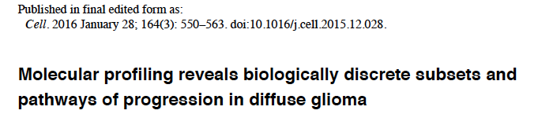
RNASeq DGEA Statistical Packages
02/23/18 Group Meeting KBh
Limma
DESeq/DESeq2
EBSeq
baySeq
PoissonSeq
SAMSeq
EdgeR
They used EdgeR in a different context-combined with other data (thus leading to one more normalization step in their case, but starting with the same TCGA Level 3 RNAv2RSEM data that we are using

