Slide 1
Symptoms of
Inflammatory Bowel Disease,
Sleep, &
Alterations in the Gut Microbiome
Meredith L. Wilcox, MPH
PHC 6067 Class Project
Fall 2021

Slide 2
Description of Data
177 fecal samples from 81 participants
  Note: There are 178 fecal samples, but I’m unable to link one sample a participant ID.
  TBD: Which sample to include in analysis for participants with multiple samples?
The Human Microbiome Project (HMP) performed 16S rRNA gene compositional analysis to summarize the composition and structure of the bacterial component of the microbiome.
Of the 81 participants with 16S rRNA data, 54 had inflammatory bowel disease (34 Crohn’s Disease; 20 ulcerative colitis).
Of the 81 participants with 16S rRNA data, 41 provided baseline data on sleep measures
Of the 81 participants with 16S rRNA data, 42 provided data on IBD-related symptoms

Slide 3
Sleep Measures
Sleep quality | In the past 7 days my sleep quality was…
Refreshing sleep | In the past 7 days my sleep was refreshing
Sleep problem | I had a problem with my sleep
Difficulty falling asleep | I had difficulty falling asleep
Restless sleep | My sleep was restless
Try to sleep | I tried hard to get to sleep
Worry about sleep | I worried about not being able to fall asleep
Sleep satisfaction | I was satisfied with my sleep

Slide 4
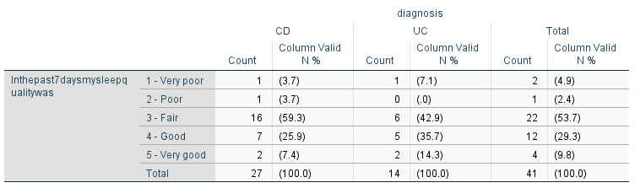
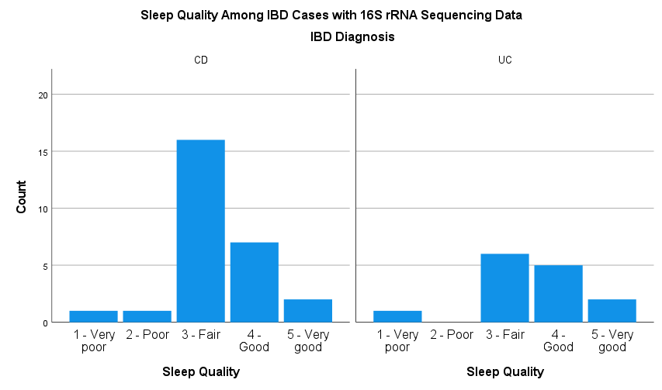
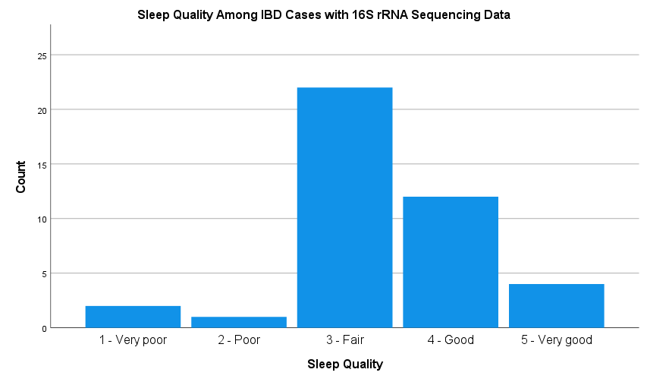
Sleep Measures – Sleep Quality

Slide 5
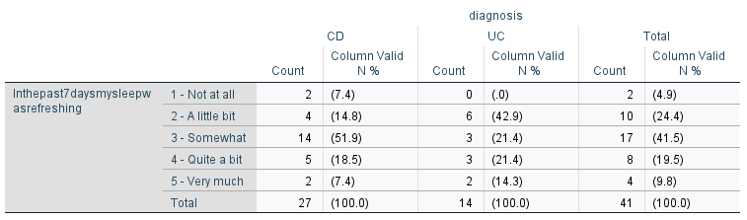
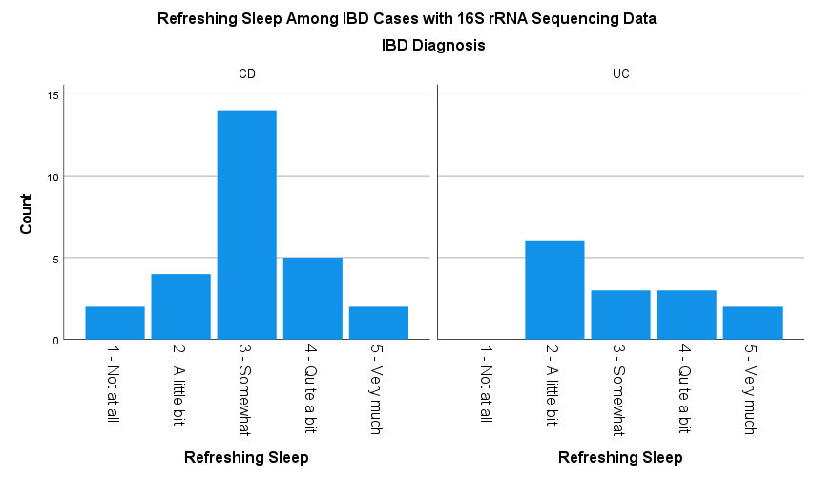
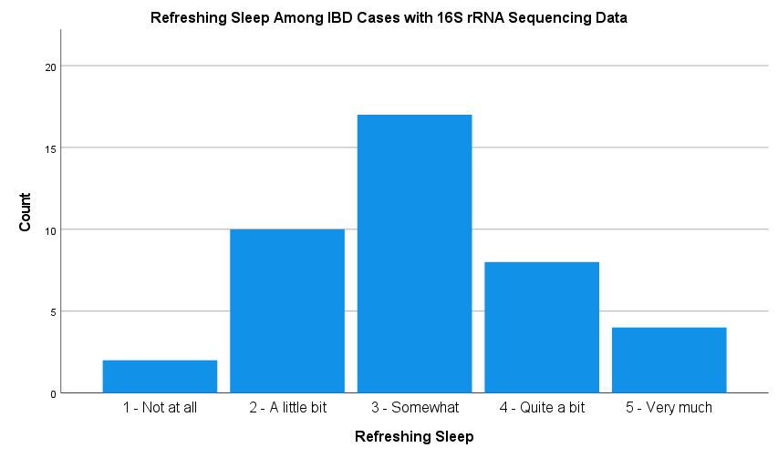
Sleep Measures – Refreshing Sleep

Slide 6
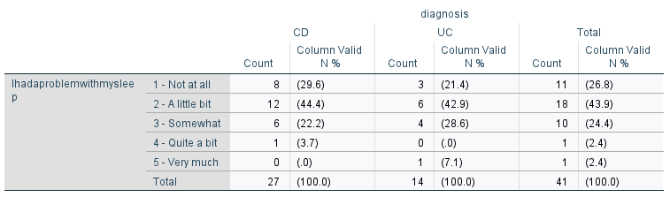
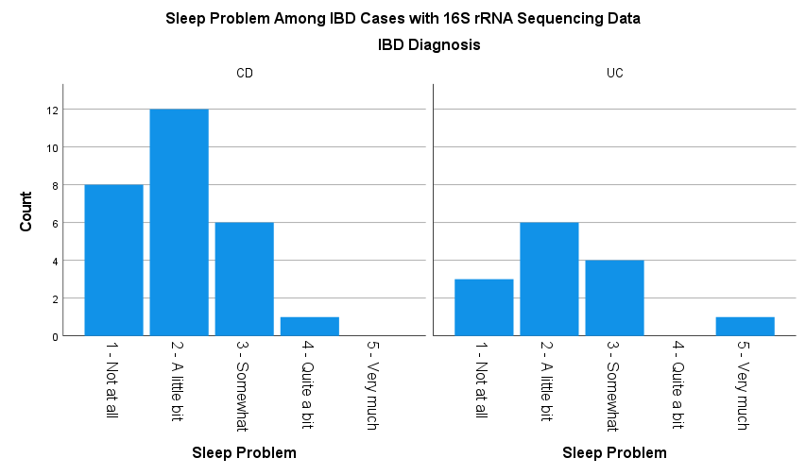
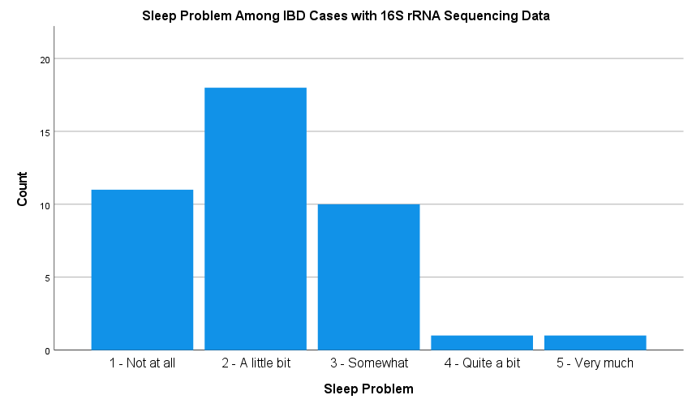
Sleep Measures – Sleep Problem

Slide 7
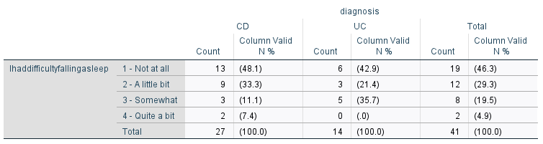
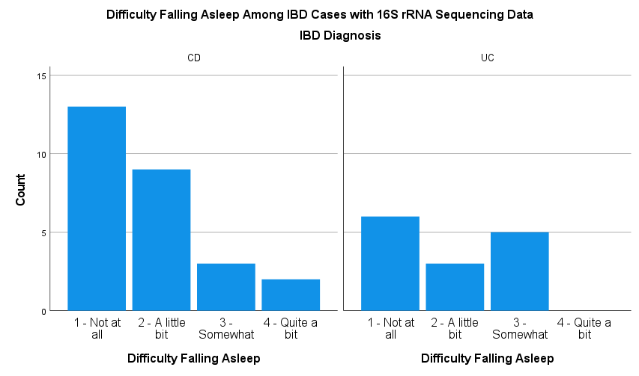
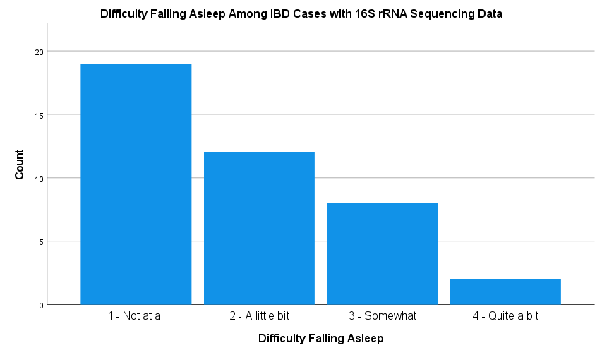
Sleep Measures – Difficulty Falling Asleep

Slide 8
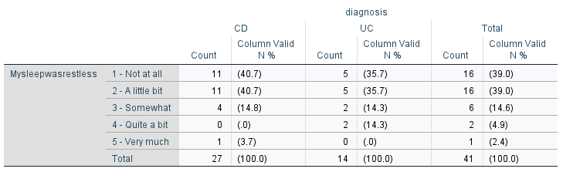
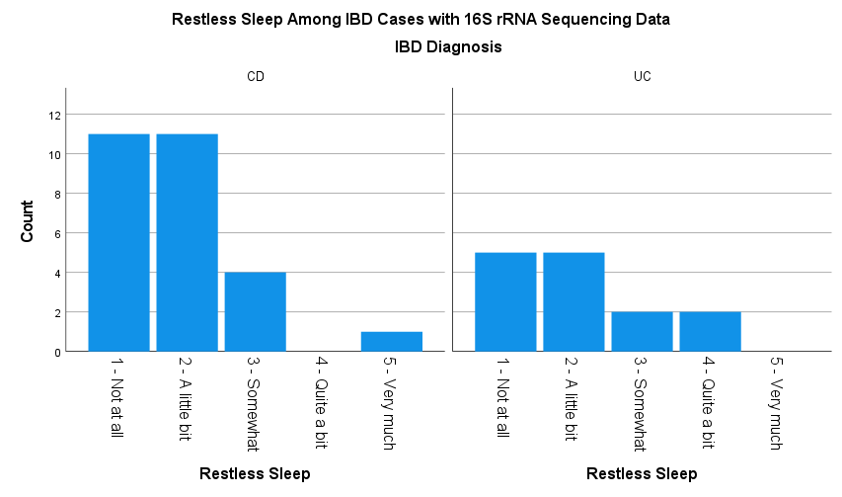
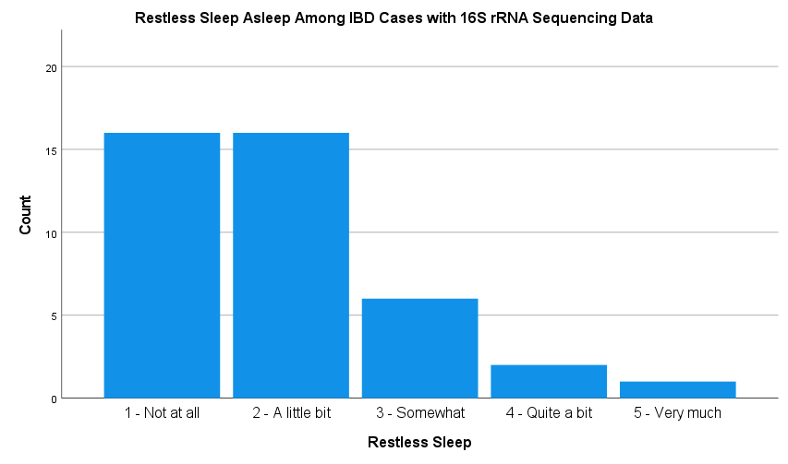
Sleep Measures – Restless Sleep

Slide 9
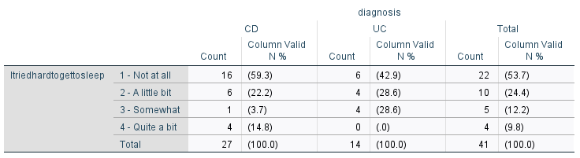
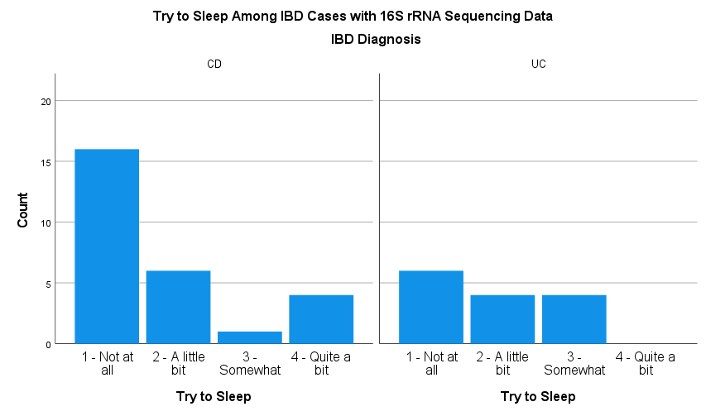
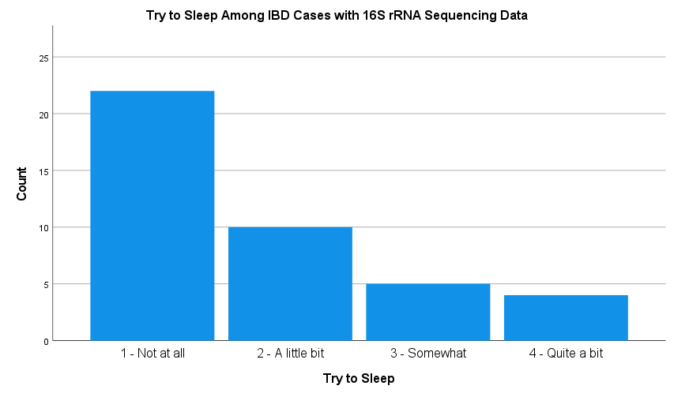
Sleep Measures – Try to Sleep

Slide 10
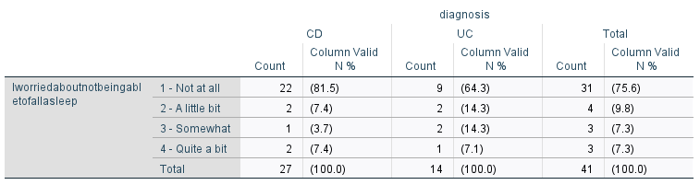
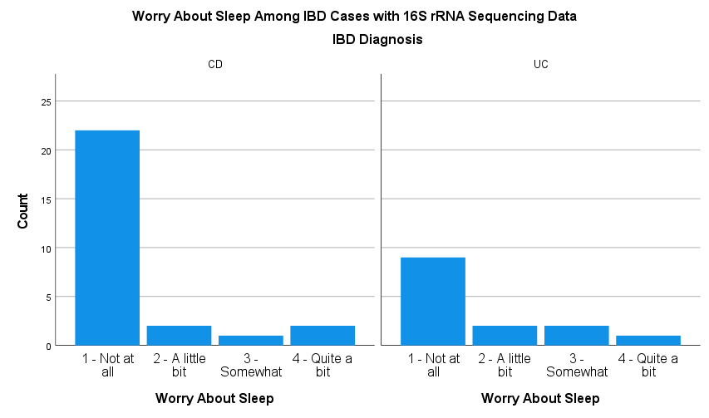
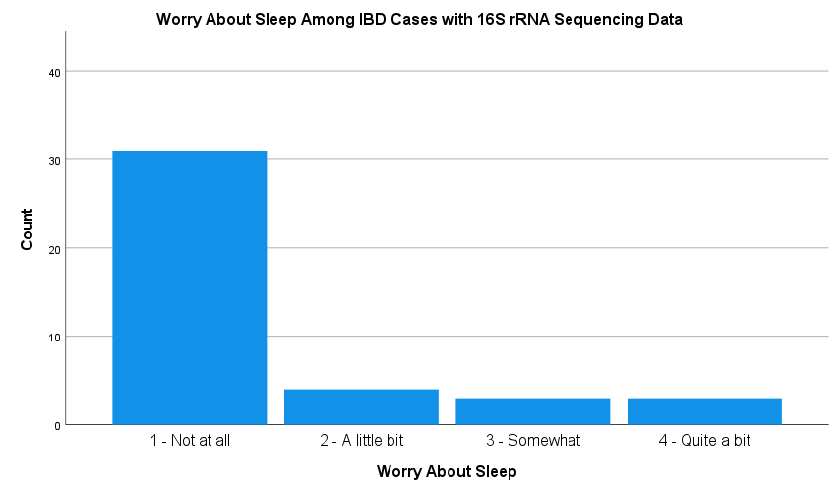
Sleep Measures – Worry About Sleep

Slide 11
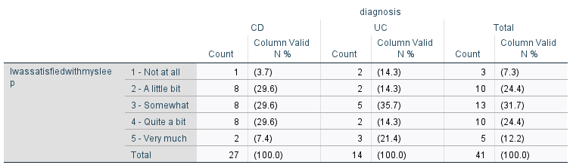
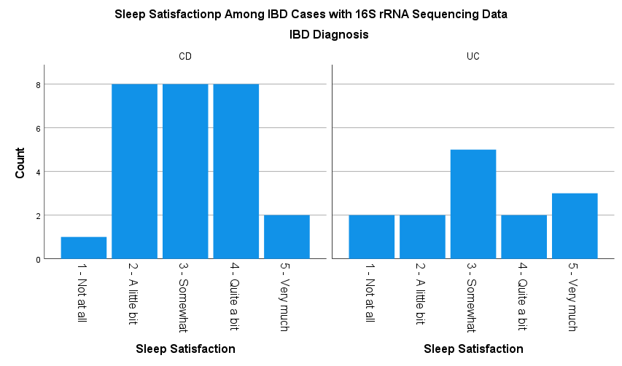
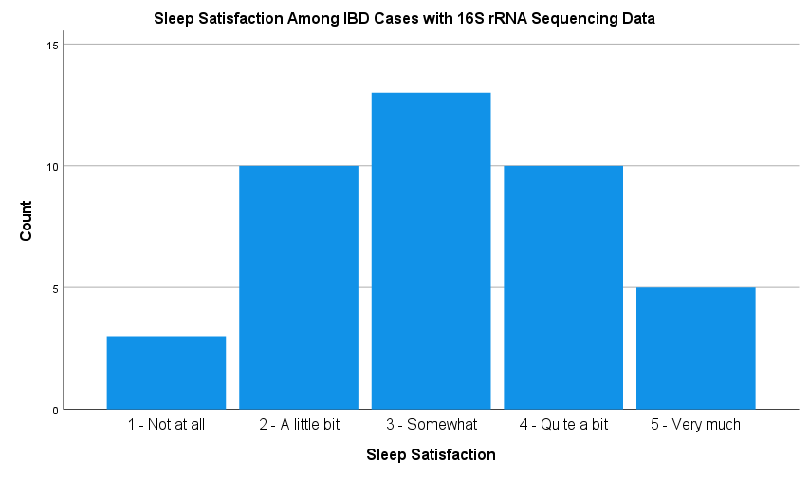
Sleep Measures – Sleep Satisfaction

Slide 12
Measures of IBD Symptoms
Short Inflammatory Bowel Disease Questionnaire (SIBDQ) | Assesses recent physical, emotional, and social symptoms or difficulties of IBD 10-item questionnaire scored from 7-70 Lower scores indicate greater severity of IBD-related symptoms or difficulties
Simple Clinical Colitis Activity Index (SCCAI) | Assesses the physical symptoms of ulcerative colitis (UC), including bowel frequency, urgency of defection, blood in stool, general wellbeing, and extracolonic features Higher scores indicates greater severity of UC symptoms
Harvey-Bradshaw Index (HBI) | Assesses the severity of clinical symptoms of Crohn’s Disease Higher scores indicates greater severity of CD symptoms

Slide 13
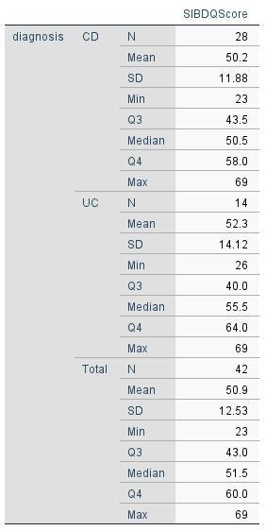
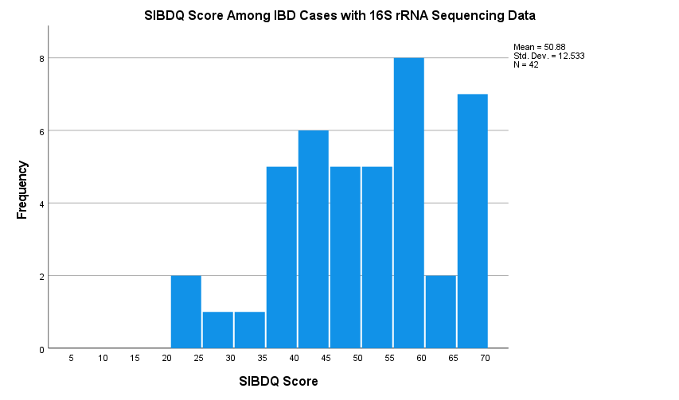
Short Inflammatory Bowel Disease Questionnaire (SIBDQ)

Slide 14
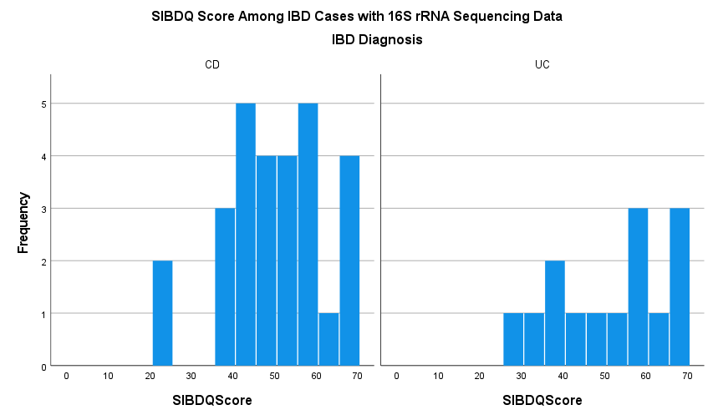
Short Inflammatory Bowel Disease Questionnaire (SIBDQ)

Slide 15
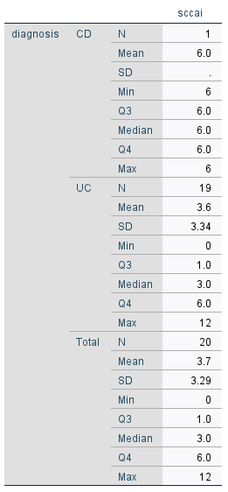
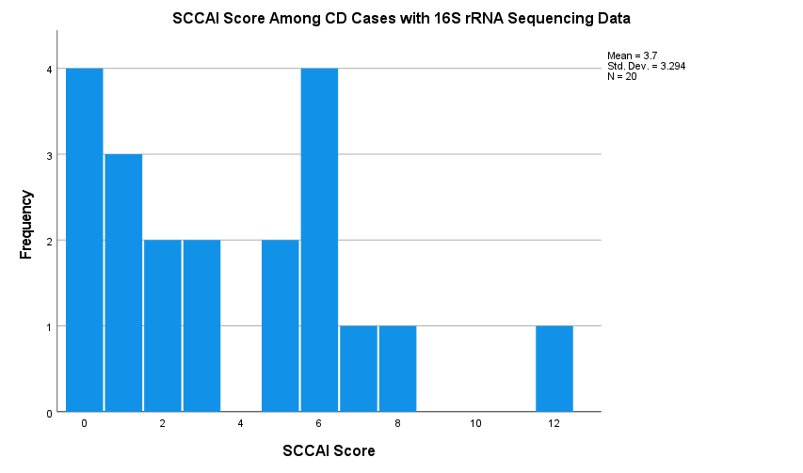
Simple Clinical Colitis Activity
Index (SCCAI)

Slide 16
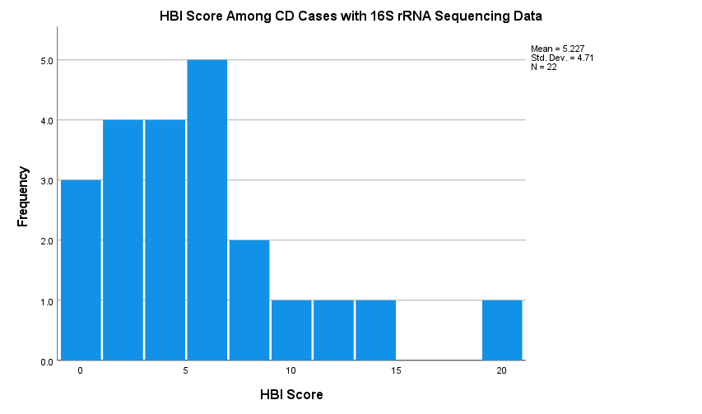
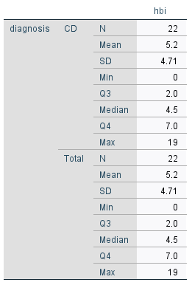
Harvey-Bradshaw Index (HBI) for CD

Slide 17
Decisions made…
Include IBD diagnosis as a random variable in model
Resulting from the above decision, I will be using SIBDQ as the outcome. The SIBDQ was completed at baseline by both CD and UC patients.

Slide 18
Next Steps…
Decide whether to include individual sleep measures in models or use a composite score. (Need to find out more information regarding the 8 sleep measures.)
Look into software/package options for microbiome data (QIIME, R packages APE and VEGAN)
Diversity calculations
  Alpha diversity (Shannon diversity index, Shannon evenness index)
  Beta diversity (Bray-Curtis dissimilarity, Jaccard distance, UniFrac)

