Slide 1
Symptoms of
Inflammatory Bowel Disease,
Sleep, &
Diversity in the Gut Microbiome
Meredith L. Wilcox, MPH
PHC 6067 Class Project
Fall 2021

Slide 2
Objective & Hypothesis
Objective: The proposed analysis aims to establish whether sleep measures and diversity in the gut microbiome are associated with clinical symptoms in inflammatory bowel disease (IBD).
Hypothesis: Increased within-sample microbial diversity and improvements in sleep measures are associated with decreased clinical symptoms in IBD.

Slide 3

Description of Data
The Human Microbiome Project (HMP) performed 16S rRNA gene compositional analysis to summarize the composition and structure of the bacterial component of the microbiome.
982 operational taxonomy units (OTUs)
177 samples from 81 participants
  There are 178 samples, but I’m unable to link one sample to a participant ID.
  Some participants have multiple samples. The first sample ID was selected for each participant.
Of the 81 participants with 16S rRNA data, 54 had IBD.
Of the 54 IBD patients with 16S rRNA data, 39 provided baseline data on sleep measures and IBD symptoms

Slide 4
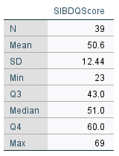
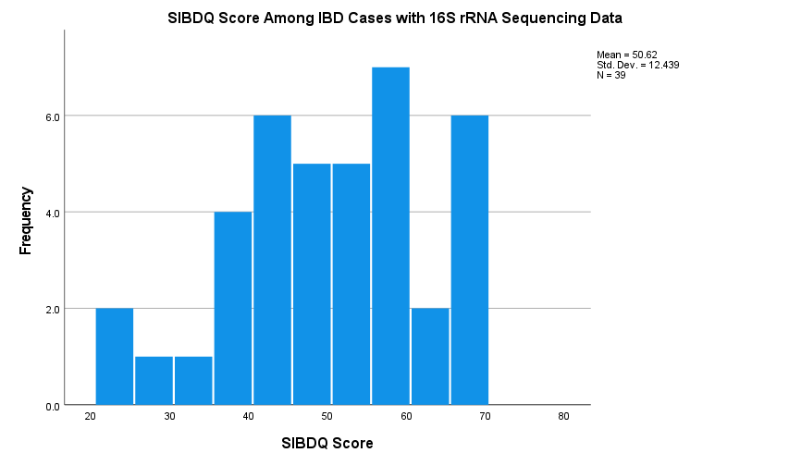
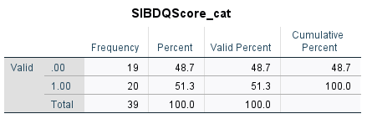
Measure of IBD Symptoms:
Short Inflammatory Bowel Disease Questionnaire (SIBDQ)
Assesses recent physical, emotional, and social symptoms or difficulties of IBD
10-item questionnaire scored from 7-70
Lower scores indicate greater severity of IBD-related symptoms or difficulties

Slide 5
Sleep Measures
Sleep quality | In the past 7 days my sleep quality was…
Refreshing sleep | In the past 7 days my sleep was refreshing
Sleep problem | I had a problem with my sleep
Difficulty falling asleep | I had difficulty falling asleep
Restless sleep | My sleep was restless
Try to sleep | I tried hard to get to sleep
Worry about sleep | I worried about not being able to fall asleep
Sleep satisfaction | I was satisfied with my sleep

Slide 6
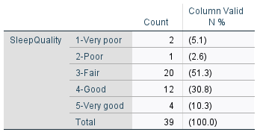
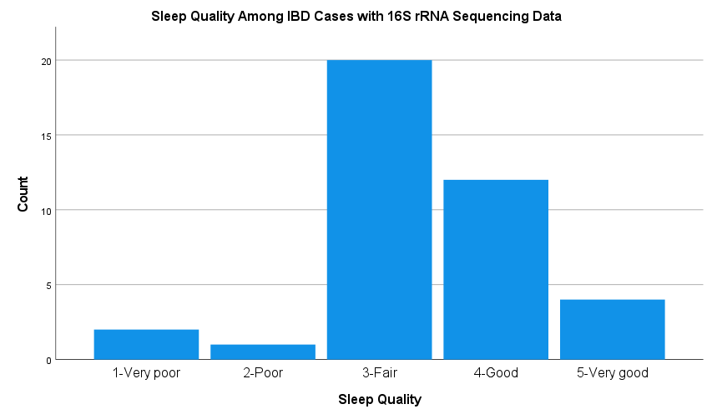
Sleep Measures – Sleep Quality

Slide 7
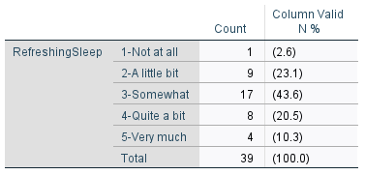
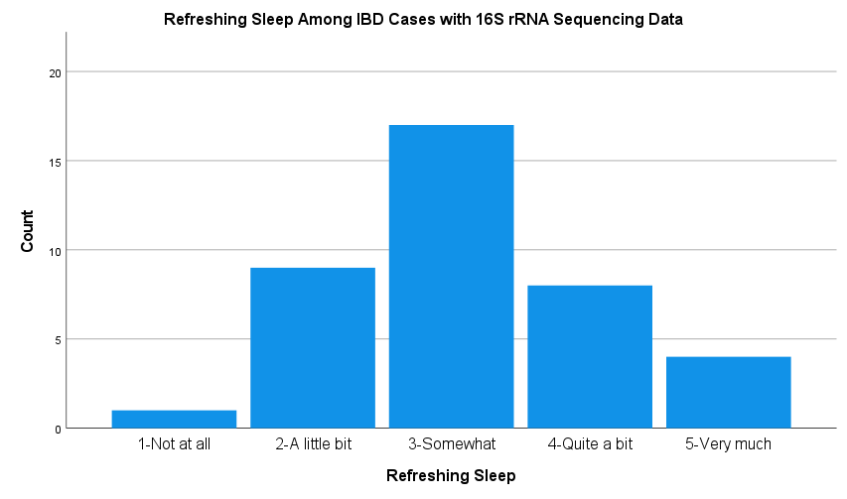
Sleep Measures – Refreshing Sleep

Slide 8
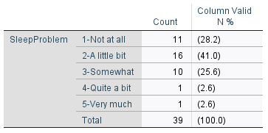
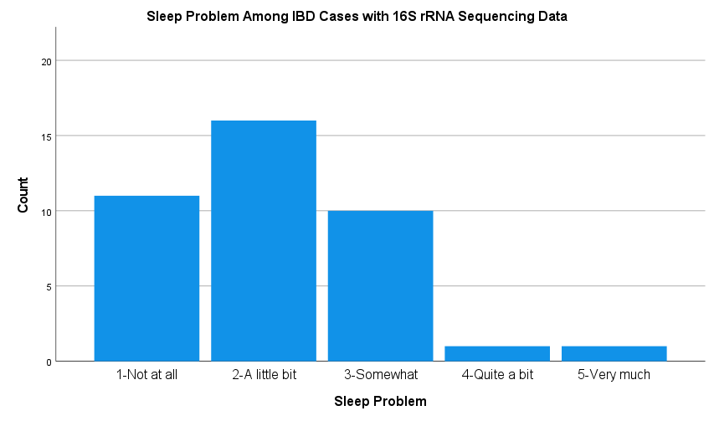
Sleep Measures – Sleep Problem

Slide 9
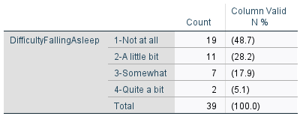
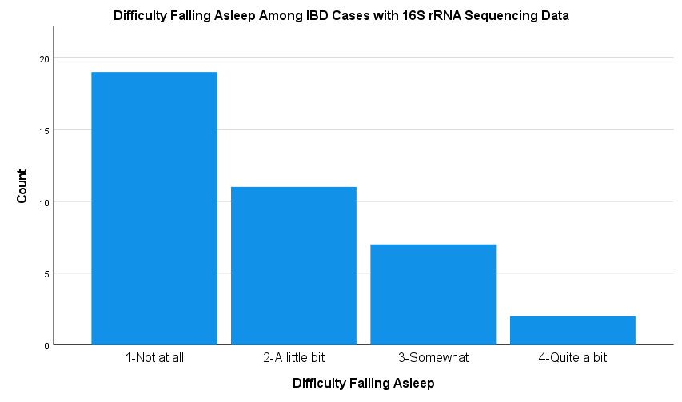
Sleep Measures – Difficulty Falling Asleep

Slide 10
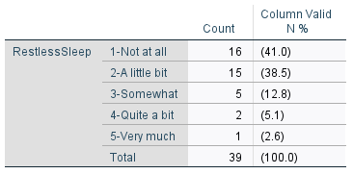
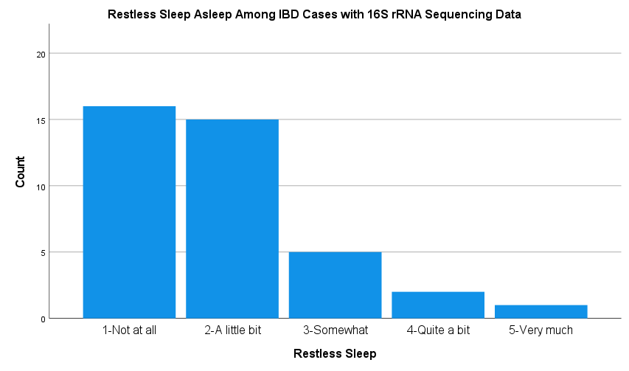
Sleep Measures – Restless Sleep

Slide 11
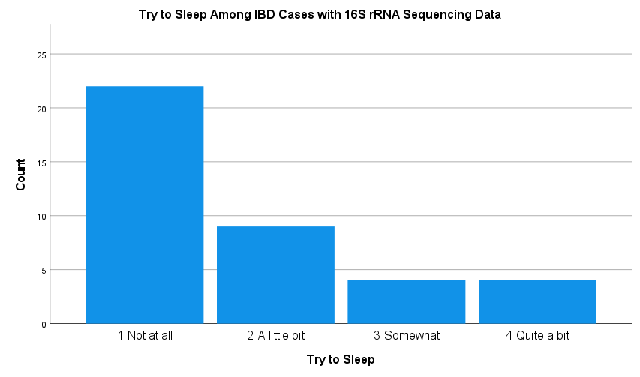
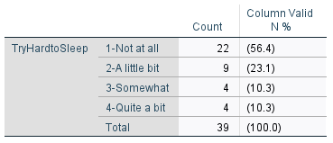
Sleep Measures – Try to Sleep

Slide 12
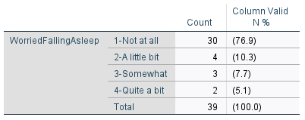
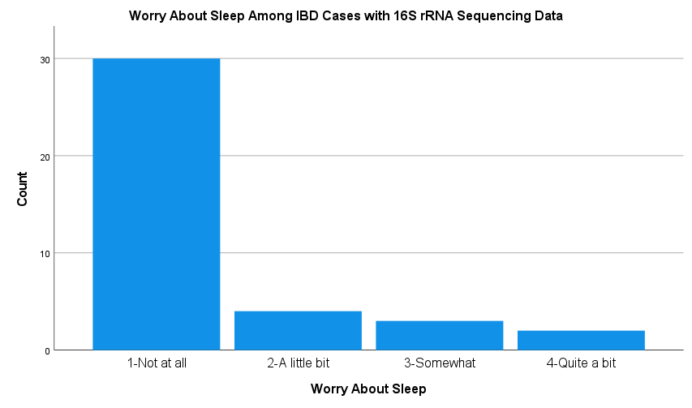
Sleep Measures – Worry About Sleep

Slide 13
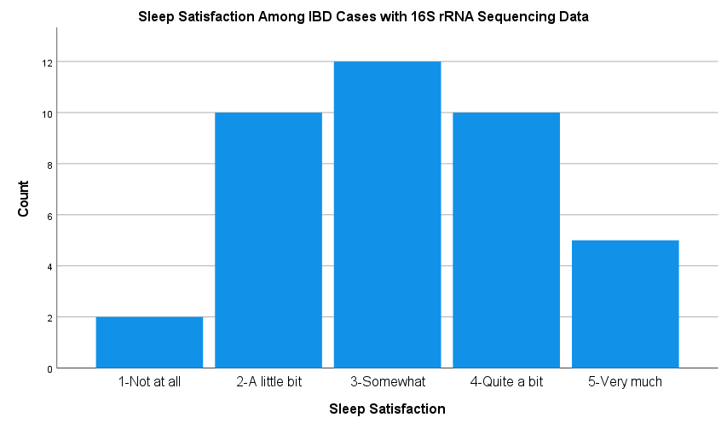
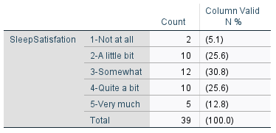
Sleep Measures – Sleep Satisfaction

Slide 14
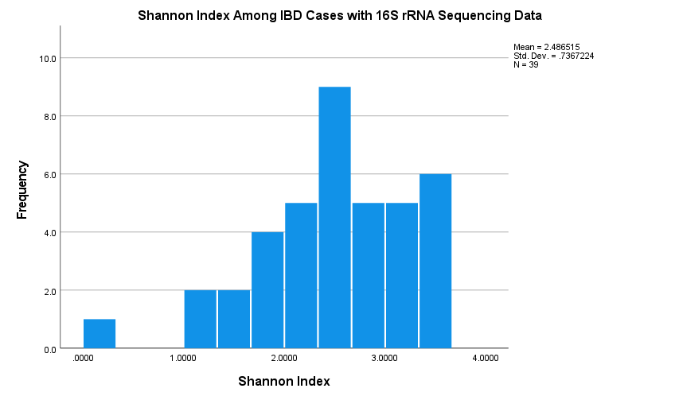
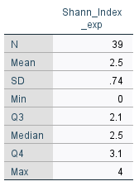
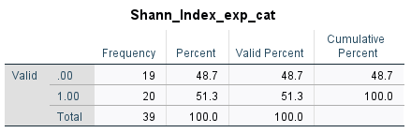
Gut Microbiome – 16S rRNA data
Shannon Diversity Index – evaluates alpha
(within sample diversity).

Slide 15
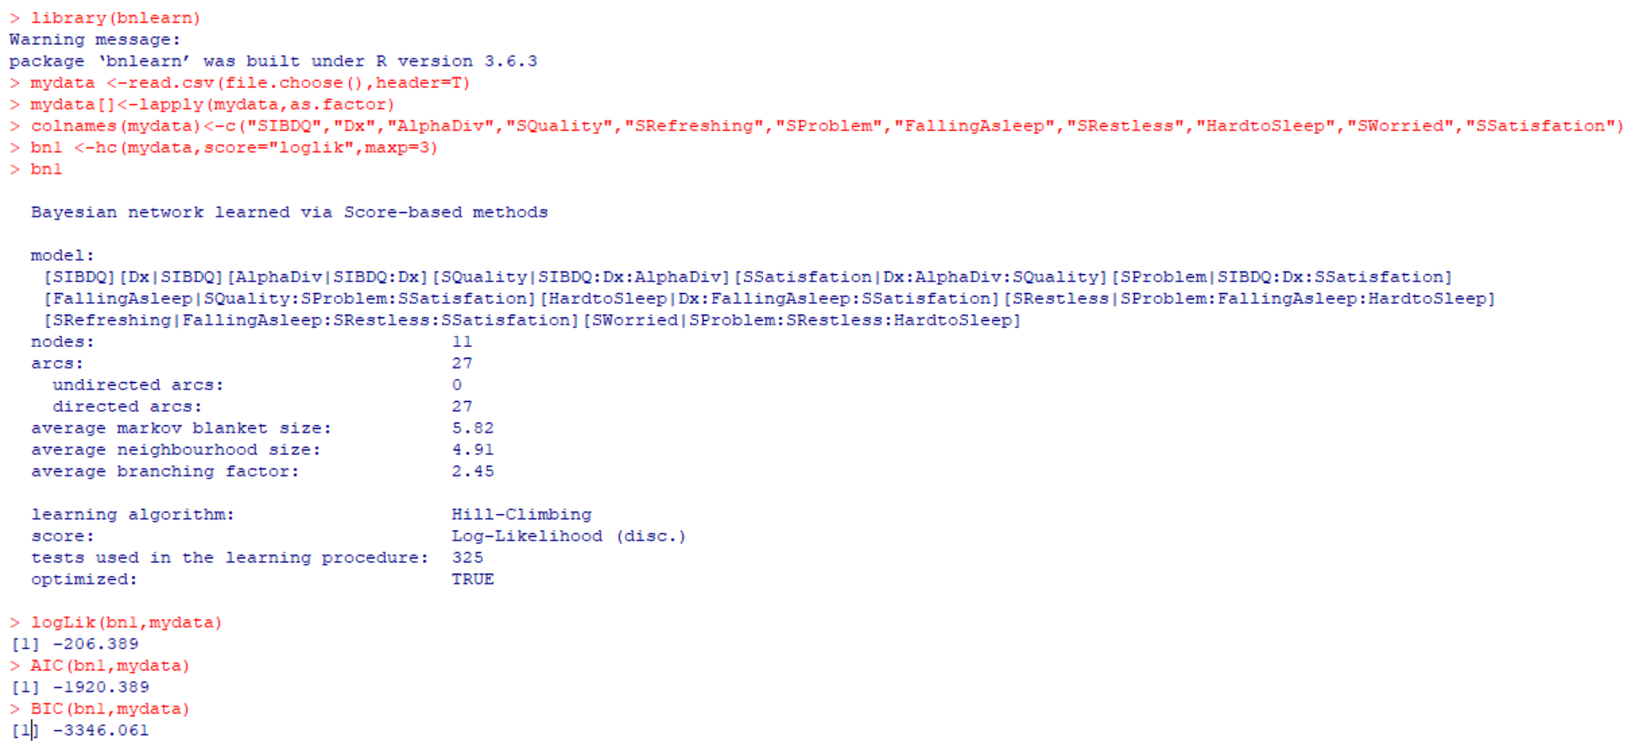
Bayesian Structure Learning

Slide 16
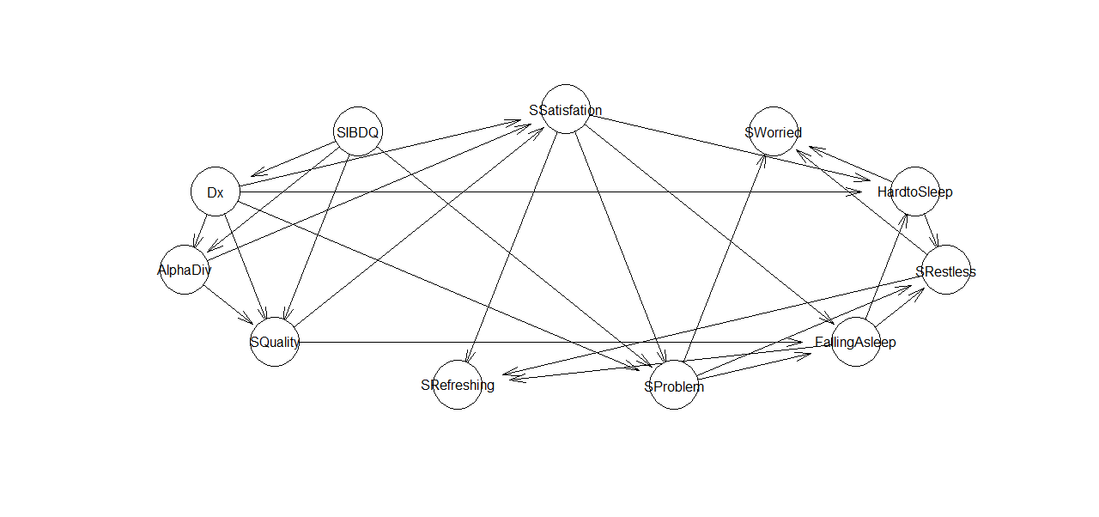

Bayesian Structure Learning

