Slide 1
Alterations in the Gut Microbiome Associated with Inflammatory Bowel Disease
Meredith L. Wilcox, MPH
PHC 6067 Class Project
Fall 2021

Slide 2
Objective & Hypothesis
Objective: The proposed analysis aims to explore the association between the gut microbiome and inflammatory bowel disease (IBD) diagnosis

Slide 3
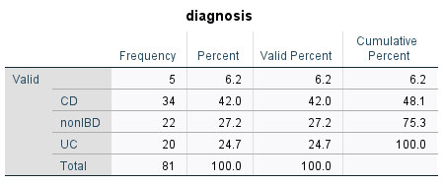
Description of Data
The Human Microbiome Project (HMP) performed 16S rRNA gene compositional analysis to summarize the composition and structure of the bacterial component of the microbiome.
982 operational taxonomy units (OTUs)
177 samples from 81 participants
  There are 178 samples, but I’m unable to link one sample to a participant ID.
  Some participants have multiple samples. The first sample ID was selected for each participant.
Of the 81 participants with 16S rRNA data, 34 have Crohn’s Disease, 20 have ulcerative colitis, 22 do not have IBD, and 5 have unknown diagnosis.

Slide 4


Gut Microbiome – 16S rRNA data
Step 1: Normalize counts within each sample to account for potential unequal quantities of starting RNA.
Total-Sum Scaling (TSS): Transforms the counts into relative abundances by dividing each count by the sample’s library size
Step 2: Calculate log2 fold-change for CD vs. nonIBD and for UC vs. nonIBD
1E-10 was added to all mean values to account for mean values of 0
Step 3: Select OTUs with largest for CD vs. nonIBD and for UC vs. nonIBD

Slide 5
Gut Microbiome – 16S rRNA data
Step 4: Discretize relative abundance based on mean relative abundance
Step 5: Use bnlearn in R to learn Bayesian Network
Input variables: IBD diagnosis (CD, UC, nonIBD); discretized relative abundances for the ~40 OTUs identified in Step 3
Method: Hill climbing algorithm based on log likelihood score, allowing for maximum 3 parents per node

Slide 6
Gut Microbiome – 16S rRNA data
OTU IDs identified for CD vs. nonIBD:
OTU IDs identified for UC vs. nonIBD:
Gt8Met68 | HibDuja7 | Unc99918 | IVUSpe88
HZLSpe15 | HZLSpe44 | Unc85608 | Unc00nbb
Unc01aer | Unc02j5n | Unc03q53 | HXVAqu20
Unc00rn9 | Unc04om7 | Unc03pyu | ISXSp105
Unc02xsu | Unc75554 | Unc02ndx | HZLDaeje
Unc99918 | Unc05nw6 | Unc03tc5 | Unc05lxa
Unc00bcu | Gt8Met60 | Unc02158 | Unc99751
Unc81868 | UncPel24 | Unc008ji | GHQSpe52
Unc00rn9 | Unc75554 | Unc03e44 | HKTDura4
Unc04ti7 | VeeSemin | Unc05n7t | F1NS2664

Slide 7
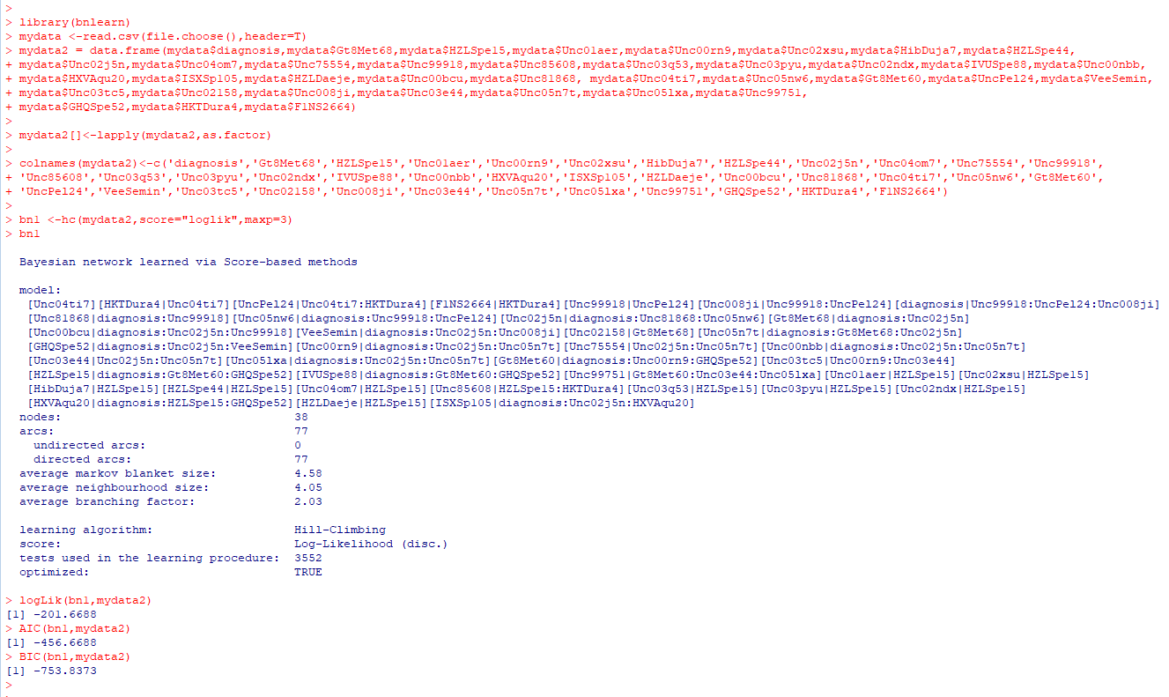
Bayesian Structure Learning

Slide 8
Bayesian Structure Learning

