Slide 1
Comparison of Naïve Bayes Classifier with Logistic regression-Machine learning algorithms by using Glioblastoma tumor expression data.
SHASANK CHENNUPATI

Slide 2
Introduction
Hypothesis: Expression of candidate genes including their demographics can help in identifying a trend of responses occurring in glioblastoma and thereby help in early risk identification in new patients.
The AIM of the project is to identify and develop a best model than can predict Glioblastoma comparatively.
Models tested-
-Logistic Regression
-Naïve Bayes Classifier

Slide 3
Methods:
Data Procurement:
All the data on patients with GBM are from
The Cancer Genome Atlas (TCGA) and
Gene Expression Omnibus(GEO)
Sample determination:
For the purpose of this study we have laid down a strict criteria.

Slide 4
Inclusion criteria:
Disease: Glioblastoma.
Level 2 and 3 of Data (Normalized data, processed data).
Data type: Clinical and Gene Expression data.
Cases with available Gene Expression data and Demographics data.

Slide 5
Exclusion criteria:
Cancers not GBM.
Cases without demographics in database.
Cases with low or no Availability of Gene data in TCGA database.
Based on above criteria 184(84-TCGA, 100 from GEO) cases of data were filtered.

Slide 6
Data Cleaning
Total of 184 patients data was selected form TCGA and GEO databases. similar genes across the datasets were matched and missing data was removed leaving 179 patients. Total of more than 20,000 genes were present in both the data sets combined.
The data was standardized individually and later merged to create single dataset.
6769(6766+genes+Age+Gender+Race) were matching among the datasets

Slide 7
The data were passed through statistical software and probability is calculated. prediction ratio of correct vs incorrect give the training error.

Slide 8
Measurement comparison between 2 models
Goodness of fit
Training Error
Area under the ROC* curve (AUC), calibration, and run time.
* Receiver operating characteristic (ROC), or ROC curve, is a graphical plot that illustrates the performance of a binary classifier system as its discrimination threshold is varied. The curve is created by plotting the true positive rate (TPR) against the false positive rate (FPR) at various threshold settings.

Slide 9
RESULTS

Slide 10
NBC-Full Model
Time elapsed: 1min
Training Error: 0.424581
Log LikelihoodL: -Inf
Cross Validation: Accuracy---0.9809

Slide 11
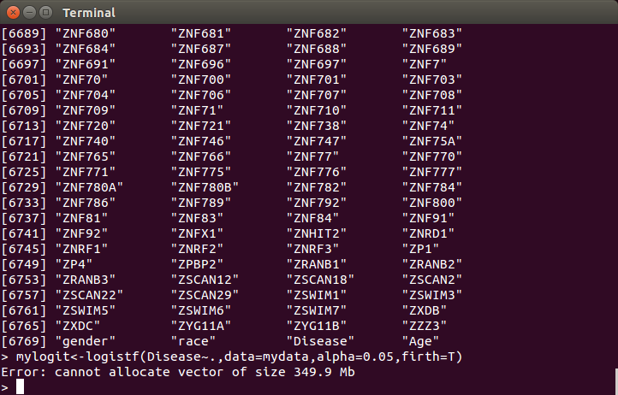
Logistic regression-Full Model
Time elapsed
3 days

Slide 12
Model selection
Step wise correlation took 3 days to work and ended with a non Responding Message.
One to one correlation was chosen as a best choice.
493 variables were selected based on Correlations(p<0.05) from 6769

Slide 13
Selected model-NBC
Loglikelihood: –Inf
training.error: 0.4357542
Time elapsed 10sec
Cross validation---Accuracy : 0.9709

Slide 14
Logistic regression
Model Fit Statistics
Criterion | Intercept Only | Intercept and Covariates
AIC | 445.156 | 1086.717
-2 Log L | 443.156 | 750.717
Testing Global Null Hypothesis: BETA=0
Test | Chi-Square | DF | Pr > ChiSq
Likelihood Ratio | -307.5615 | 167 | <.0001
Wald | 5942272.42 | 167 | <.0001

Slide 15
Cross Validation for reduced model model
3 fold
Internal estimate of accuracy = 0.994
Cross-validation estimate of accuracy = 0.615
10 fold
Internal estimate of accuracy = 0.994
Cross-validation estimate of accuracy = 0.52
Training error: 0.4239

Slide 16
Goodness of FIT
Hosmer and Lemeshow Goodness-of-Fit Test
Chi-Square | Pr > ChiSq
10.8580 | 0.2099

Slide 17
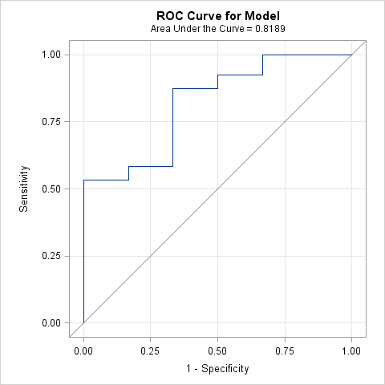
Logistic model- AUC

Slide 18
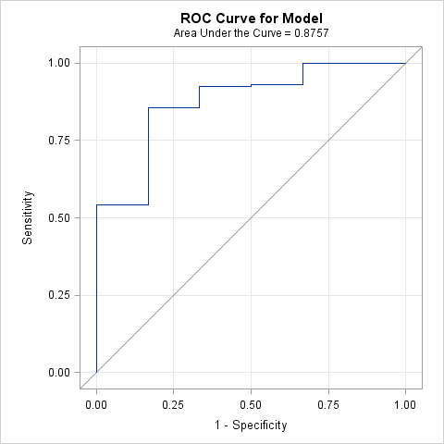
naiveBayes AUC

Slide 19
0.9809 | NaiveBayes algorithm |  | Logistic regrerssion model
 | Full model | Selected model | Full model | Selected model
Time elapsed | 1 min | 10sec | >3 days | 8 hours
Training error | 0.424581 | 0.4357542 | - | 0.4239
Cross validation | 0.9809 | 0.9709 | - | 0.994
Log likelihood | -Inf | -249 | - | -375.35
AIC | - | - | - | 1086.717
BIC | - | 1623 | - | -
AUC | - | 0.8757 | - | 0.8189

Slide 20
Conclusion
Based on the above results and the discussion Naïve Bayes is the best algorithm for predictive analysis of genetic data.

