Slide 1
Comparison of Naïve Bayes Classifier with Logistic regression-Machine learning algorithms by using Glioblastoma tumor expression data.
SHASANK CHENNUPATI

Slide 2
Introduction
Hypothesis: Expression of candidate genes including their demographics can help in identifying a trend of responses occurring in glioblastoma and thereby help in early risk identification in new patients.
Data Procurement:
All the data on patients with GBM are from
The Cancer Genome Atlas (TCGA) and
Gene Expression Omnibus(GEO)

Slide 3
Inclusion criteria
Exclusion criteria
Disease: Glioblastoma.
Level 2 and 3 of Data (Normalized data, processed data).
Data type: Clinical and Gene Expression data.
Cases with available Gene Expression data and Demographics data.
Cancers not GBM.
Cases without demographics in database.
Cases with low or no Availability of Gene data in TCGA database.
Based on above criteria 184(84-TCGA, 100 from GEO) cases of data were filtered.

Slide 4
Measurement comparison between models
Goodness of fit
Training Error
Area under the ROC* curve (AUC), calibration, and run time.
* Receiver operating characteristic (ROC), or ROC curve, is a graphical plot that illustrates the performance of a binary classifier system as its discrimination threshold is varied. The curve is created by plotting the true positive rate (TPR) against the false positive rate (FPR) at various threshold settings.

Slide 5
Data Cleaning
Total of 184 patients data was selected form TCGA and GEO databases. similar genes across the datasets were matched and missing data was removed leaving 179 patients. 6769(6766+genes+Age+Gender+Race) were matching among the datasets
Data Standardization:
Z score conversion.
Data Discretization/Dichotomization:
Mean is taken as cut-off to obtain Discretized data.

Slide 6
Model selection
Step wise correlation took 3 days to work and ended with a non Responding Message.
One to one correlation was chosen as a best choice for selecting models.
493 variables were selected based on Correlations(p<0.05) from 6769 variables.

Slide 7
Descriptors of Selected Model
Name of Genes | N | Minimum | Maximum | Mean | Std. Deviation
AASDHPPT | 179 | -0.77738 | 0.83756 | -0.11416 | 0.27481
ABCB8 | 179 | -1.00505 | 0.39918 | -0.09024 | 0.28062
ABHD13 | 179 | -0.56953 | 0.94645 | -0.03031 | 0.307058
ABHD14B | 179 | -1.00181 | 1.00805 | -0.12853 | 0.370657
ACAD11 | 179 | -0.91975 | 0.91555 | 0.165462 | 0.332608
ACAD9 | 179 | -0.97962 | 0.12263 | -0.24746 | 0.211779
ACOT4 | 179 | -1.75792 | 0.68091 | -0.51301 | 0.49462
ACPT | 179 | -0.24598 | 0.50252 | 0.021142 | 0.175012
ACTA2 | 179 | -0.36035 | 4.52538 | 0.910977 | 1.395486
Disease | Frequency
0-No Disease | 6
1-Disease | 173
Total | 179
Race | Frequency
0 | 3
1 | 157
2 | 11
3 | 8
Total | 179
Gender | Frequency
0 | 66
1 | 113
Total | 179
Notes:
0-Asian, 1- White, 2- African American, 3-White

Slide 8
 | Naive Bayes Algorithm |  | Logistic Regression model
Evaluators | Full model | Selected model | Full model | Selected model
Time elapsed | 1 min | 10sec | >3 days | 8 hours
Training error | 0.424581 | 0.4357542 | - | 0.4239
Cross validation | 0.9809 | 0.9709 | - | 10-Fold-0.52 3fold-0.615
Log likelihood | -Inf | -249 | - | -375.35
AIC | - | - | - | 1086.717
BIC | - | 1623 | - | -
AUC | - | 0.8757 | - | 0.8189

Slide 9
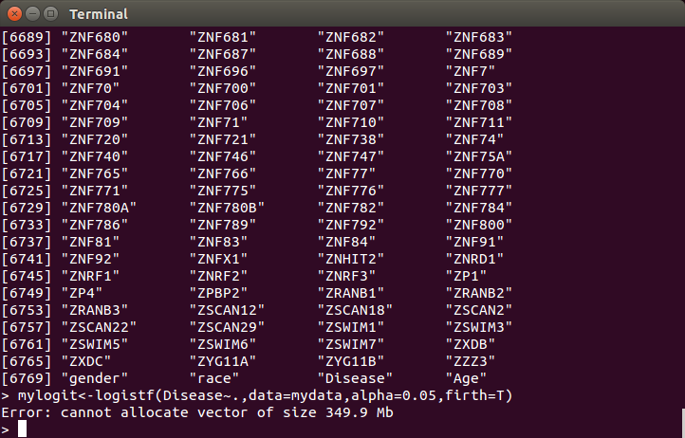
Logistic regression-Full Model
Time elapsed
3 days

Slide 10
Logistic regression-Selected model
Model Fit Statistics
Criterion | Intercept Only | Intercept and Covariates
AIC | 445.156 | 1086.717
-2 Log L | 443.156 | 750.717
Testing Global Null Hypothesis: BETA=0
Test | Chi-Square | DF | Pr > ChiSq
Likelihood Ratio | -307.5615 | 167 | <.0001
Wald | 5942272.42 | 167 | <.0001
Hosmer and Lemeshow Goodness-of-Fit Test
Chi-Square | Pr > ChiSq
10.8580 | 0.2099

Slide 11
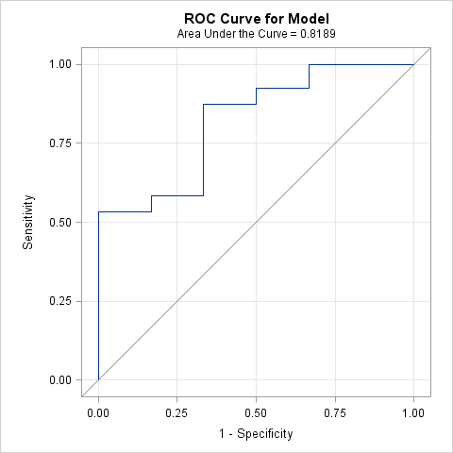
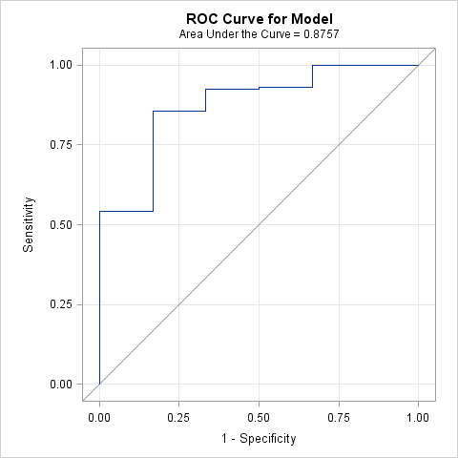
Logistic model- AUC
Naive Bayes- AUC

Slide 12
Conclusion
Based on the above results and the discussion Naïve Bayes is the best algorithm for predictive analysis of genetic data of glioblastoma.

