Slide 1
Association between HIV Testing and Depression among U.S. Youth
Christyl T. Dawson, MPH
Department of Epidemiology
Robert Stempel College of Public Health and Social Work
Florida International University
Miami, FL 33199

Slide 2

Outline
Literature review
Gap in knowledge
Objective
Hypothesis
Methods
Results
Conclusion

Slide 3
Literature review
In the U.S., youth account for a substantial number of HIV infections (CDC, 2015).
However, more than 50% of youth do not know their HIV status despite increasing participation in sexual activity (CDC, 2015; CDC, n.d.).
Knowing one’s HIV status is imperative for effective and efficient treatment of HIV (Fisher, 2008)
HIV testing behavior has been found to be associated with gender, socioeconomic status, education, and history of sexually transmitted diseases (Johns, Bauermeister, & Zimmerman, 2010; Schnall, Rojas, & Travers, 2015).

Slide 4
Gaps in knowledge
No studies have yet examined the association between different psychosocial attributes, particularly depression, and HIV testing among U.S. youth in a large representative sample.
Most studies have not used a large, representative sample of youth in the U.S.

Slide 5
Objective
Examine the association between depression and HIV testing behavior among U.S. youth.

Slide 6
Hypothesis
Depression will be negatively associated with HIV testing behavior among U.S. youth.

Slide 7
Methods
Data source- CDC 2013 National Youth Risk Behavior Surveillance Survey (YRBSS)
Population- U.S. youth in 9th through 12th grade
Sampling method- 3 stage cluster sampling
Sample size- 13,583
Statistical models- logistic regression, naïve Bayes classifier
Dependent variable- HIV test (yes/no)
Independent variables- depression, sexual behavior, HIV/AIDs education, grade level, age, ethnicity, gender, race, alcohol/drug use including IDU

Slide 8
Model building- reference coding, cases with missing values deleted, variable selection via literature
Model comparison- AIC, ROC curves, 2-fold cross validation
Estimates obtained- counts, percentages, p-values, and odds ratios with 95% confidence intervals
Statistical software- R version 3.2.2

Slide 9
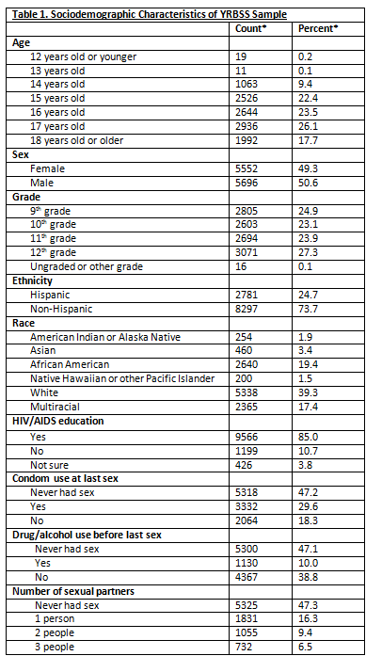
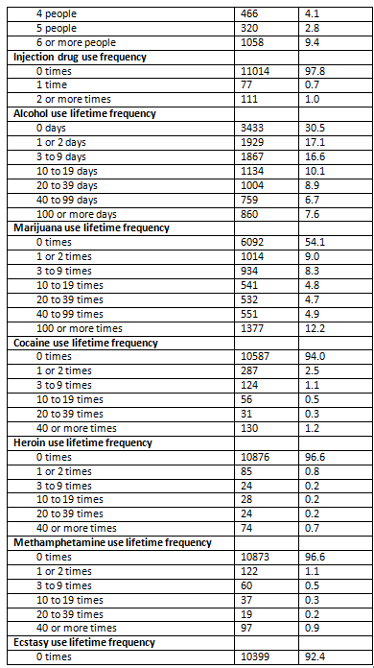
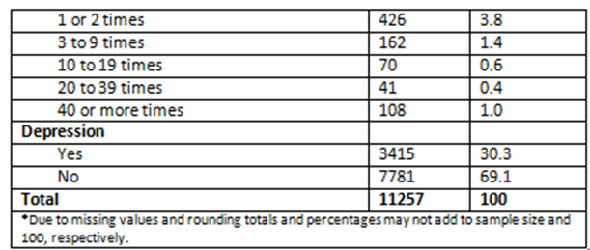
Results

Slide 10
Table 2. Chi-square Tests of Associations between HIV Testing Behavior and Sociodemographic Characteristics, YRBSS 2013 Sample
 | x² | p-value
Age | 292.5 | <0.001
Sex | 21.0
Grade | 167.4
Ethnicity | 2.0 | 0.163
Race | 171.0 | <0.001
HIV/AIDS education | 8.6 | 0.014
Condom use at last sex | 861.6 | <0.001
Drug/alcohol use before last sex | 860.3
Number of sexual partners | 1203.2
Injection drug use frequency | 94.8
Alcohol use lifetime frequency | 303.8
Marijuana use lifetime frequency | 514.7
Cocaine use lifetime frequency | 188.3
Heroin use lifetime frequency | 110.7
Methamphetamine use lifetime frequency | 158.7
Ecstasy use lifetime frequency | 250.1
Depression | 90.4

Slide 11
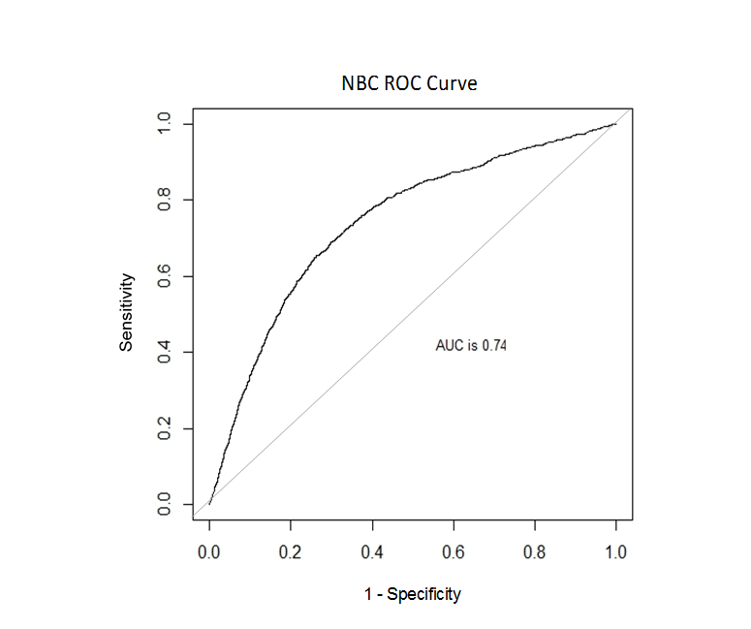
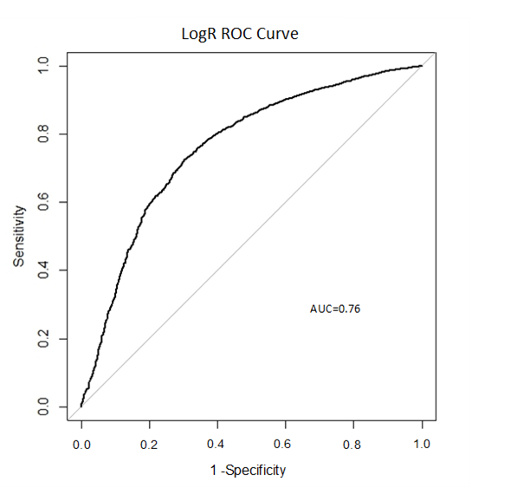
Logistic regression
Naïve Bayes classifier
Log likelihood= -3677.55
AIC=7391.1
2-fold cross validation
  Estimate of accuracy: 0.85
Log likelihood= -19366.94
AIC= 58581.87
2-fold cross validation
  Estimate of accuracy: 0.86

Slide 13
Conclusion
Depression associated with lower odds of HIV testing among U.S. youth
Additional studies needed to replicate findings
Screening for depression should be a part of interventions for uptake of HIV testing

Slide 14
References
Centers for Disease Control and Prevention. (2015). HIV among youth. Retrieved from http://www.cdc.gov/hiv/group/age/youth/.
Centers for Disease Control and Prevention. (n.d.). Trends in the Prevalence of Sexual Behaviors and HIV Testing, National YRBS: 1991-2013. Retrieved from http://www.cdc.gov/healthyyouth/data/yrbs/pdf/trends/us_sexual_trend_yrbs.pdf.
Fisher, M. (2008). Late diagnosis of HIV infection: major consequences and missed opportunities. Current opinion in infectious diseases, 21(1), 1-3.
Johns, M. M., Bauermeister, J. A., & Zimmerman, M. A. (2010). Individual and neighborhood correlates of HIV testing among African American youth transitioning from adolescence into young adulthood. AIDS education and prevention: official publication of the International Society for AIDS Education, 22(6), 509.
Schnall, R., Rojas, M., & Travers, J. (2015). Understanding HIV testing behaviors of minority adolescents: a health behavior model analysis. Journal of the Association of Nurses in AIDS Care, 26(3), 246-258.

