Slide 1
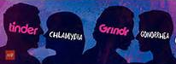

Swiping Right for an STD: Social-Networking Smartphone Applications, Risky Behaviors, and Sexually Transmitted Disease
Isabel S. Griffin, MPH

Slide 2
Sexually Transmitted Diseases
According to the World Health Organization, one million sexually transmitted infections (STIs) are acquired every day, worldwide.¹
Each year in the United States, 19 million people are diagnosed with an STD, costing the U.S. healthcare system 16 billion dollars.²
  Half of these new cases occur among young people ages 15 to 24.
  10,000 teens are infected by an STD everyday, which is one every 8 seconds.
Most young adults weigh the cost and benefit of safe sex practices, the fact that STDs are treatable and HIV is no longer a death sentence.
In 2013, 56% of specimens submitted from Miami-Dade County to the CDC Gonococcal Isolate Surveillance Project (GISP) were resistant to at least one course of antibiotics used to treat Neisseria gonorrhoeae cases, while approximately 26% were multidrug resistant.³
Notes:
According to the World Health Organization, 357 million new infections occur each year with one of four sexually transmitted infections (STIs): Chlamydia, gonorrhea, syphilis and trichomonisasis (WHO, 2015). This equates to approximately 1 million sexually transmitted infections (STIs) acquired every day worldwide (WHO, 2015). Each year in the United States, 19 million people are diagnosed with a sexually transmitted disease (STD), costing the U.S. healthcare system 16 billion dollars (CDC, 2015). In 2014, increased rates of Chlamydia, gonorrhea, and syphilis were reported nationwide (CDC, 2015).

Slide 3
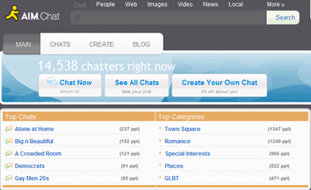
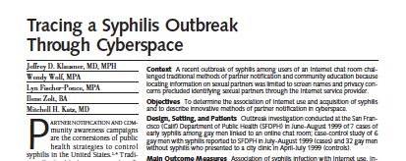
STD Outbreaks and the Internet
1990s: Online chat rooms have facilitated meeting opportunities for individuals looking to have sexual encounters.
  Men seeking men would enter these chat rooms by sending a message to the group with their age, weight, and preferred sexual act.
  In 1999, an outbreak of syphilis could traced back to a single chat room in San Francisco, California.⁴
Notes:
Since the late 1990s, online chat rooms have facilitated meeting opportunities for individuals looking to have sexual encounters. Men seeking men would enter these chat rooms by sending a message to the group with their age, weight, and sexual act preferences. The Internet became a virtual meeting space where sexually transmitted disease (STD) outbreaks, most notably an outbreak of syphilis in 1999, could be traced back to a single chat room in San Francisco, California (Dworkin, 2011). In 2007, social networking technology continued to evolve with the introduction of the Smartphone (“The IPhone Is Not a Smartphone”, 2007).

Slide 4
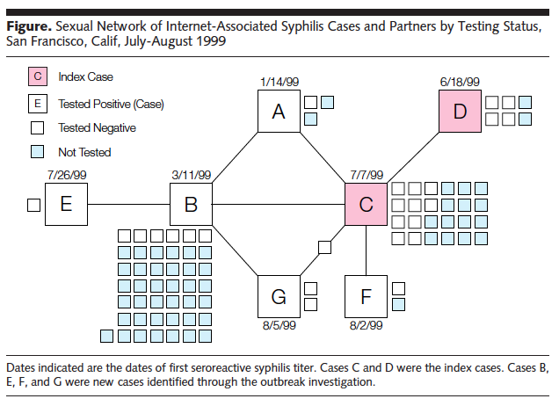

Slide 5

Sex, Drugs, and the Internet
In 2012, the California Department of Health examined primary and secondary syphilis cases among men who have sex with men (MSM) in California and Internet use to meet sex partners.⁵
  Internet users reported more sex partners (mean = 9.8) than non-Internet users (mean = 5.0; P < .001).
  Higher numbers of partners among MSM syphilis patients were associated with Internet use.
Notes:
Study period was between 2004-2008.

Slide 6

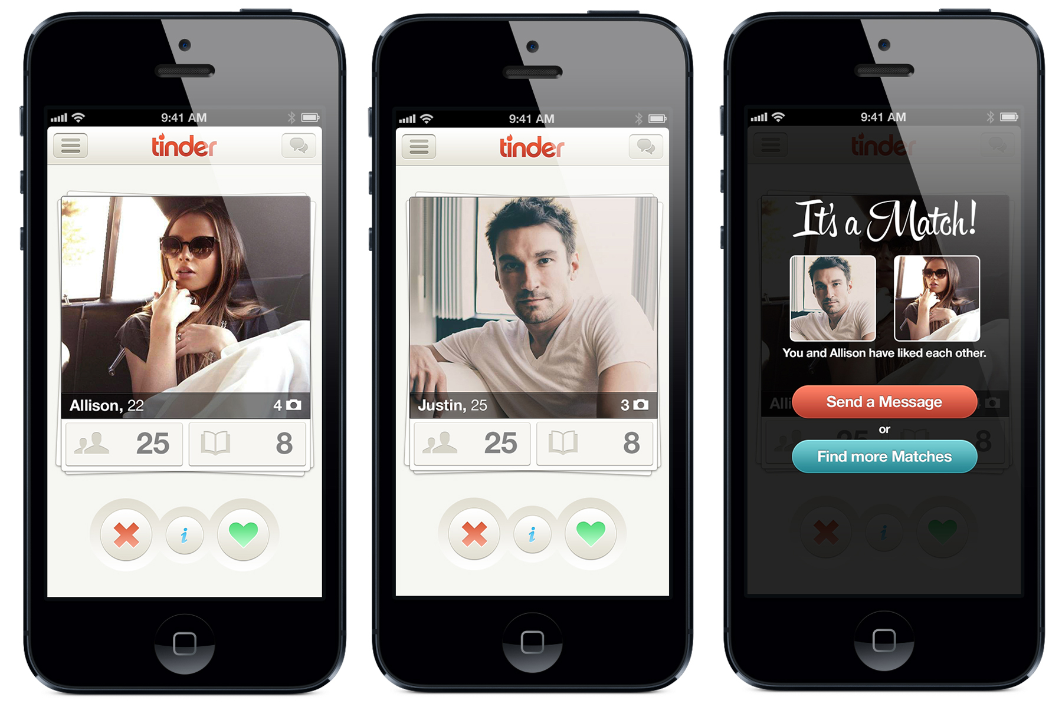
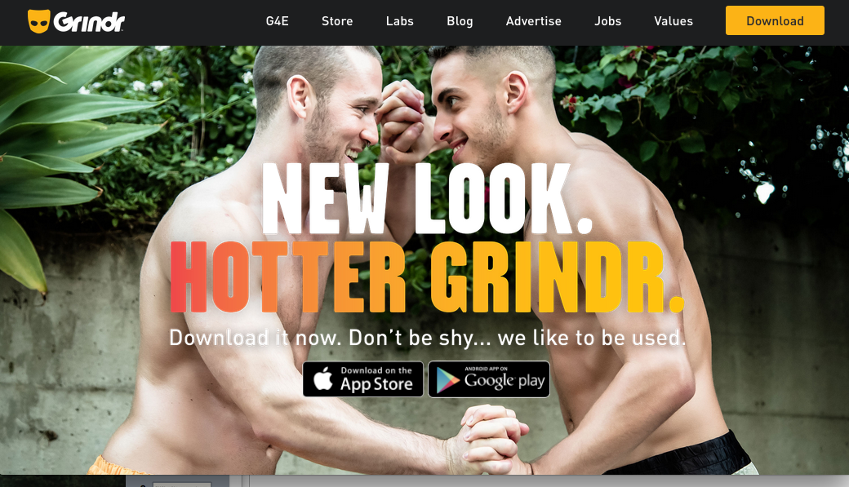

Social Networking Applications
2007: Introduction of the Smartphone.
2009: Grindr was introduced.⁴
2012: Tinder was introduced.⁵
2015: Hzone and Positive Singles were introduced.
Notes:
In 2009, the dating application (app) Grindr was introduced as a social networking platform geared towards a gay, bisexual, and bi-curious male audience (Grindr, 2016). In 2012, a similar dating app catered towards heterosexual users called Tinder was released on the market (Tinder, 2016). According to the Apple App Store, the Grindr application has over 2 million users in 196 countries using the app everyday. Users that upgrade their membership are able to “see up to 300 guys” and use advanced filters like body type, ethnicity, and relationship status preferences. The Tinder application has seen over 10 billion matches and over 100 million downloads. An upgraded Tinder user also has access to a “passport” feature, where users who are planning to travel internationally are able to connect with users anywhere in the world.
Now with a swipe of a finger, users have access to geospatial mapping software that provides the exact distance (in feet) they are from another user. This technology not only facilitates the meeting of two risky individuals, but also increases the circumference of a user’s sexual network. According to a study conducted by Delaney et al, researchers observed a mean of 33 app users per square mile at 69 sites in Atlanta, GA (Delaney et al, 2016). App users are also seeking risky sexual encounters; evident is the use of abbreviations and acronyms in user profiles, such as “SWC” which stands for “sex without condom.” According to a study by Winetrobe et. al, Grindr users that included these abbreviations in their profiles were more likely to have had unprotected anal intercourse with their last Grindr-met partner (Winetrobe, 2014).

Slide 7
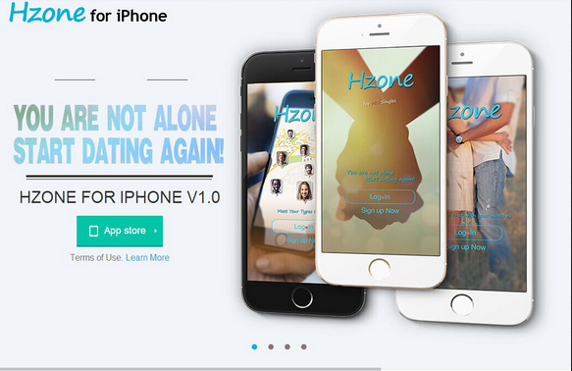
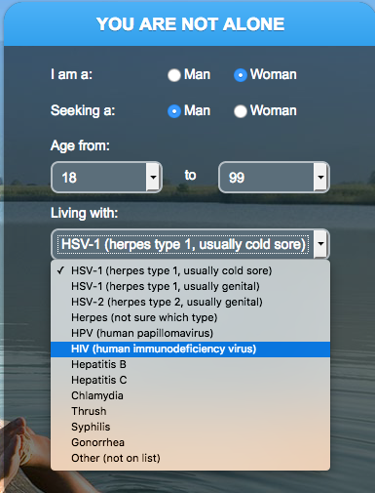
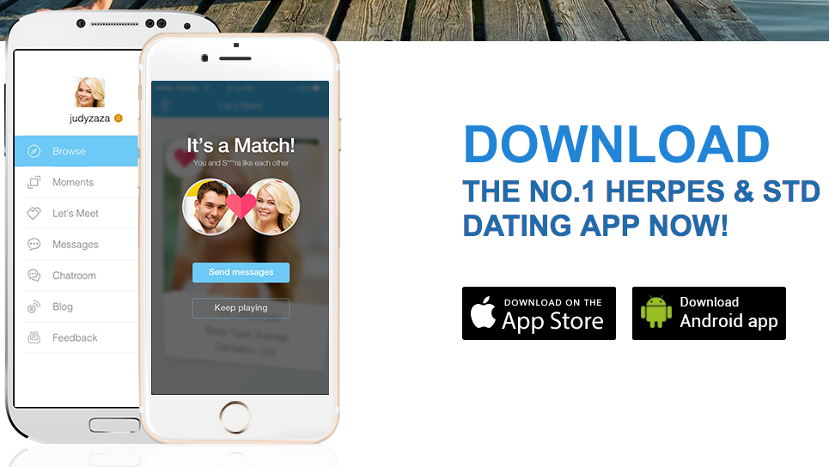
Hzone and Positive Singles

Slide 8
Are social networking application users “swiping right” for an STD?

Slide 9
Methods
Create a Bayesian Network (BN) with nodes and vectors describing the potential relationship between STDs and dating application usage.
Re-create the BN in GeNIe using probabilities obtained from background knowledge and literature review.

Slide 10
Probability of Nodes
Age: Aggregated data
Race: Aggregated data
Gender: US Census, American Community Survey
Sexual Orientation: Background Knowledge
Owning a Smartphone: Background Knowledge
App user status: Aggregated data
Condom usage status: Aggregated data
Number of Sexual Partners: Aggregated data
HIV status: Aggregated data

Slide 11
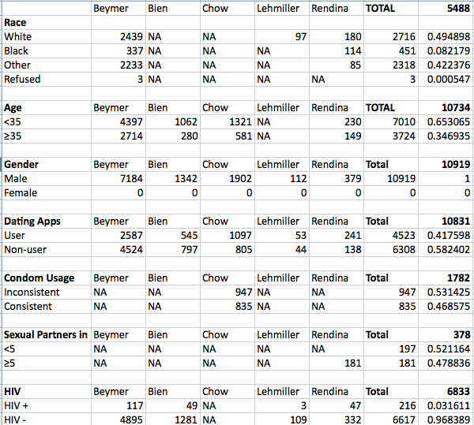
Table 1: Aggregated Data

Slide 12
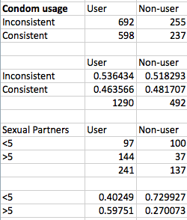
Table 2: Probabilities

Slide 13
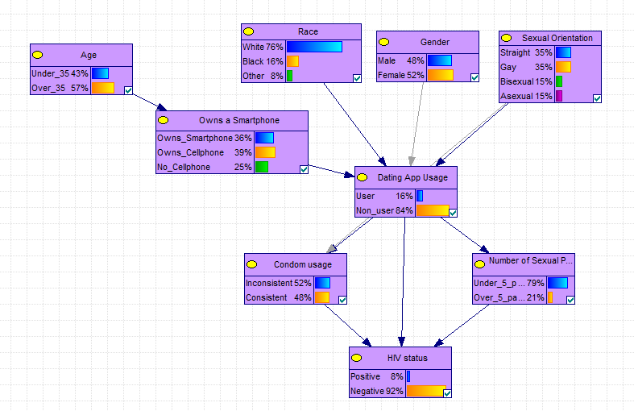
Figure 1: DAG examining HIV risk factors and app usage

Slide 14
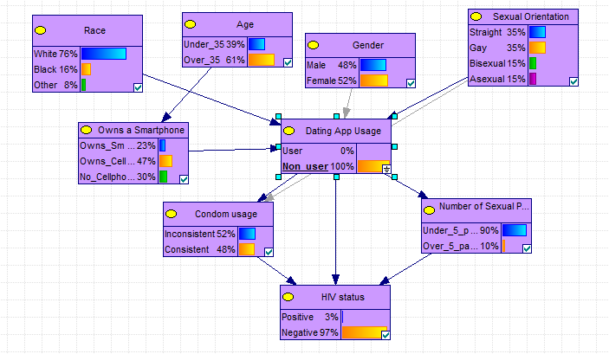
Figure 2: HIV status among Non-users

Slide 15
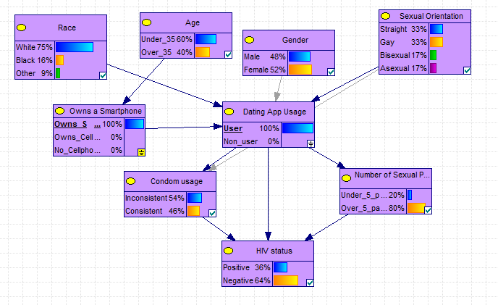
Figure 3: HIV status among App users

Slide 16
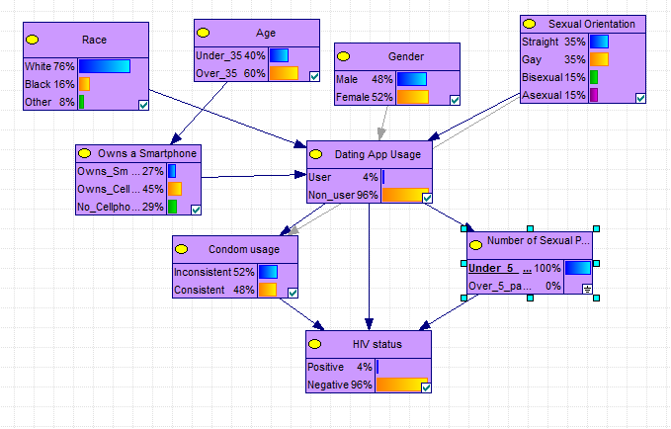
Figure 4: HIV risk among individuals reporting <5 sexual partners (4% are HIV positive).

Slide 17
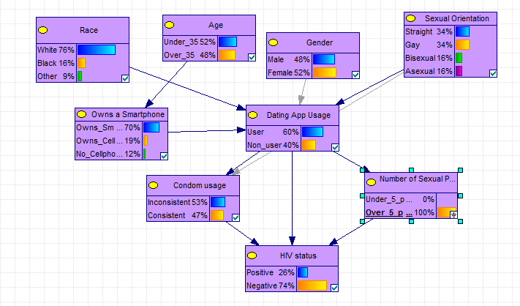
Figure 5: HIV risk among individuals reporting >5 sexual partners (26% are HIV positive).

Slide 18
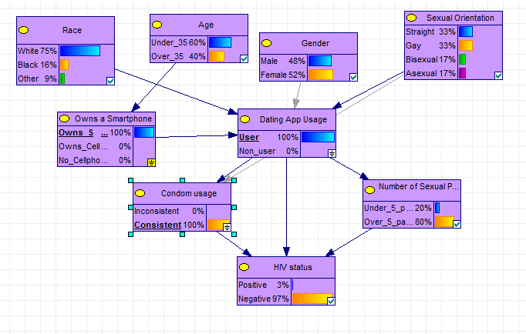
Figure 6: HIV status among individuals who own a Smartphone, use dating apps, and report consistent condom usage (3% are HIV positive)

Slide 19
Conclusions
Networks are great for showing relationships between variables—even when you don’t have individual-level data available.
Networks can also be used to show the impact of a public health interventions (for example, condom usage to prevent STDs).

Slide 20
Future Analysis
Using the Florida Cohort Data to test the previously created Bayesian Network model.
  Cross-validation
  ROC

